Slide 1

Bus Overhead Sign Guidelines
Nathan Bakken | Transit Info Data Coordinator

Slide 2
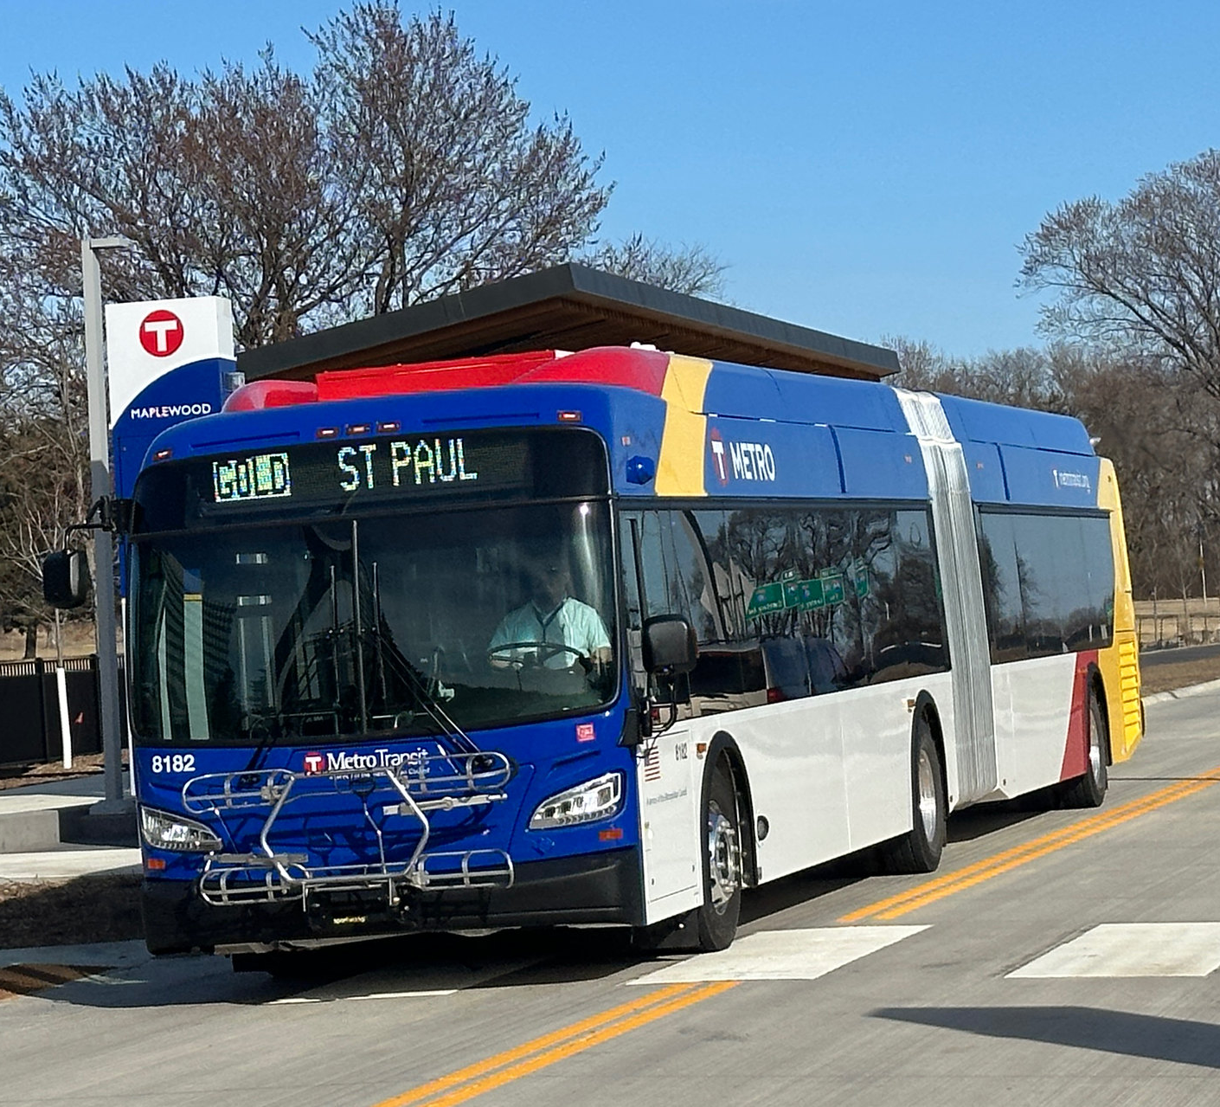
Background of Project
Purpose: Develop standards for what is displayed on bus overhead signs (Destination/Streets Traveled On), abbreviations, symbols and font sizes.
Currently there are inconsistencies
Notes:
Mention: There are inconsistences across different routes, most prevalent is many ways to represent Mall of America.

Slide 3
Proposed Guidelines So Far
The default for number of rotating panels will be 2, 3 can be used if space constraints.
Street abbreviations will follow the United States Postal Service standards.
The word “Rapid” and “Limited Stop” will be removed, “Express” will remain.
Streets traveled on will be listed first, followed by end destination.
Downtown will be replaced with DTWN MPLS or DTWN ST PAUL.

Slide 4
Request for TAAC Feedback
Should the word “Line” be included for the lettered Bus Rapid Transit routes?

Slide 5
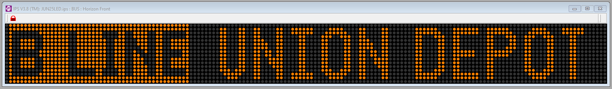
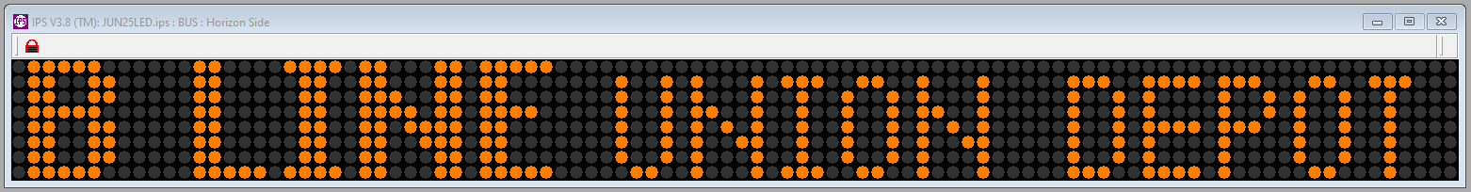
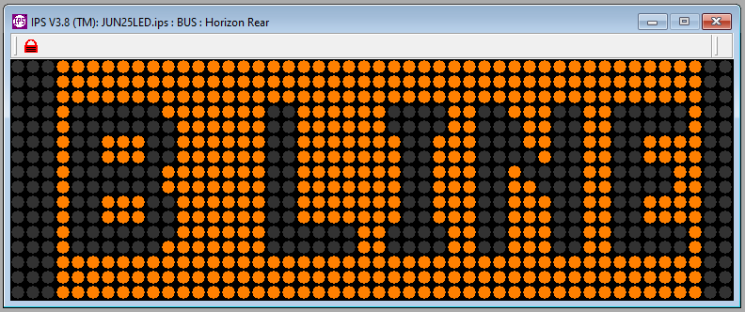
Option 1: Include “Line”
Front
Side
Back

Slide 6
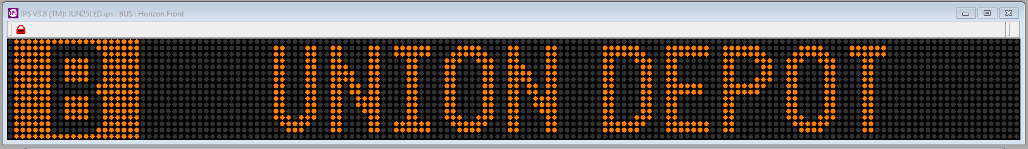
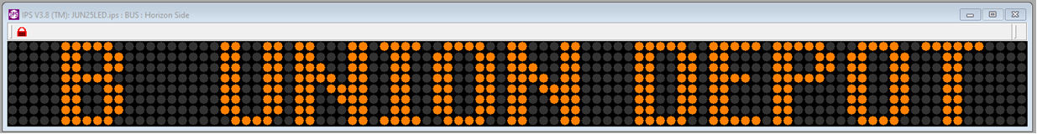
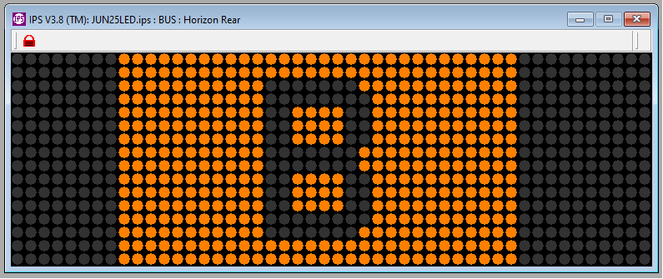
Option 2: Exclude “Line”
Front
Side
Back

Slide 7
Thank You!
Nathan Bakken
nathan.bakken@metrotransit.org
612-349-7414

