Slide 1

Metro Mobility Program Overview
Transportation Accessibility Advisory Committee, 05/07/2025
Julie Sellner, Metro Mobility Customer Service Manager, Julie.sellner@metc.state.mn.us
Cheryl Schmidt, Metro Mobility Customer Service Assistant Manager, Cheryl.Schmidt@metc.state.mn.us

Slide 2
Transit Service Structure
Metropolitan Council
Metropolitan Transportation Services
(Contracted Services)
Metro Transit
(Directly Operated)
Commuter Rail
Fixed Route Bus
Light Rail
Metro Move
Fixed Route Bus
Van Pool
Metro Mobility
Transit Link
Metro Micro
Contracted Transit Services
  All turn-key service contracts
  Service Operations and Fleet Maintenance
  Reservations and Dispatch
  Cost based on revenue hours performed
  Service Performance Criteria (Bonus/Damage Structure)

Slide 3
Metropolitan Transportation Services
Contracted Transit Services
Metropolitan Transportation Services
Executive Division Director
Charles Carlson
Contracted Transit Services
Director
Gerri Sutton
MTS Technology Systems
Manager
(Vacant)
Fixed Route
Transit Link/Van Pool/ Metro MOVE/ Metro MICRO
Manager
John Harper
Fleet Services
Manager
Paul Colton
BSA 2
(Vacant)
MOVE Program Manager
Sheila Holbrook-White
Senior Project Administrator
Sheila Brown-Williams
Rebecca McBride
Project Administrator
Bruce Dreier
Christina Pflueger
Metro Mobility
Assistant Director
Andy Streasick
Senior Project Administrator
Alex Curtis
Jodi Janssen
BSA I
Justin Allen
Project Management
Business Analyst 3
Rick Toenjes
Bus Safety
Manager
Greg Schuck
Customer Service
Manager
Julie Sellner
Operations
Manager
Clay Stenback
Assistant Manager
Cheryl Schmidt
ADA Paratransit Evaluator
David Russell
Sarah Jacobson
Senior Customer Service Rep
(Vacant)
Customer Service Rep
Pamela Hall-Clemens
Christopher Audette
Amber Eakman
Jan Pluff
Oreshia Sanders
Vienna Wilson
Senior Project Administrator
Mike Herbst
Hannah Steffens
(Vacant)
BSA 3
Mark Newell
Senior Admin Specialist
Kevin Petrie

Slide 4
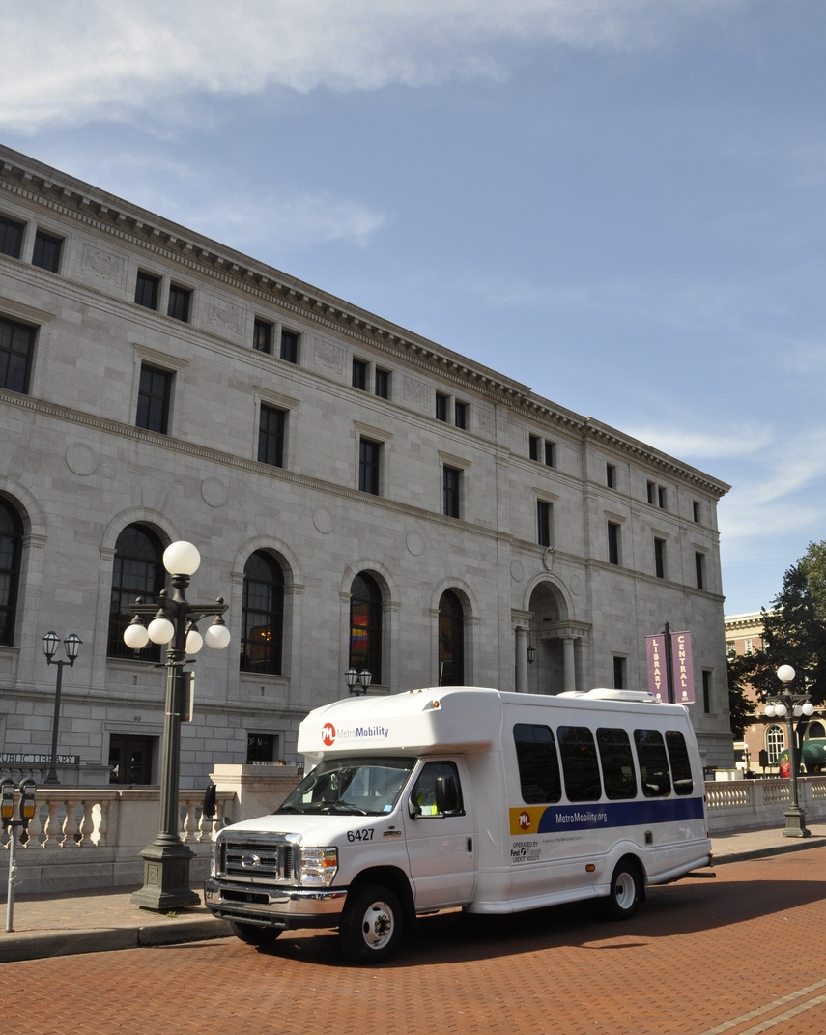
Metro Mobility Program
A shared ride, public transportation service for certified riders who are unable to use the regular fixed-route system due to a disability or health condition.
Some service guaranteed as a civil right under the Americans with Disabilities Act (ADA)
Program regulated by the Federal Transportation Administration (FTA) and state
MN Statutory requirements found in 473.386
Trips provided for any purpose
2024 Ridership: 1.8M (Approx 531K YTD 2025)

Slide 5
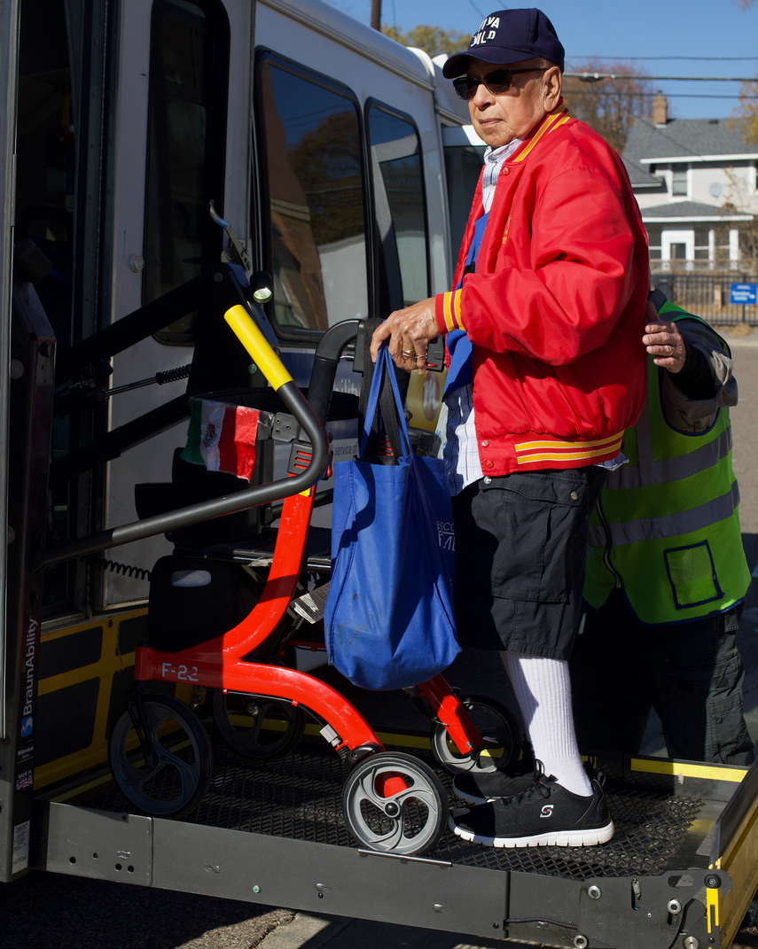
Customer Relations
Customer Profile
  ~41,000 eligible customers; ~19,000 “active” riders
  ~40% eligible for waivered transportation
  ~25% certified with conditional eligibility
  ~30% trips require use of lift
  Guests and Personal Care Attendants (PCA)
  Rides booked through contracted reservations (phone or email) or through our on-line booking system
Metro Mobility Service Center (MMSC)
  Program and Contract Administration
  Customer Services and Outreach
  Certifications and Eligibility
  ID card and Go-To Card and ID card processing
  Emergency Back-up Center

Slide 6
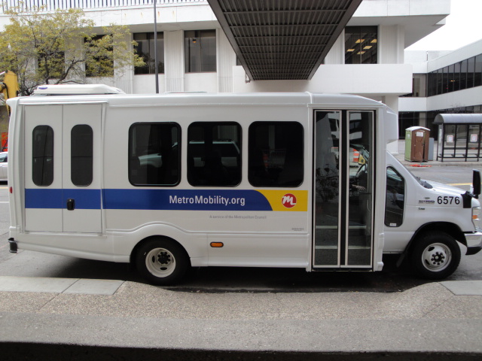
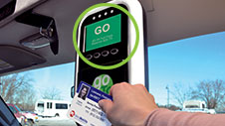
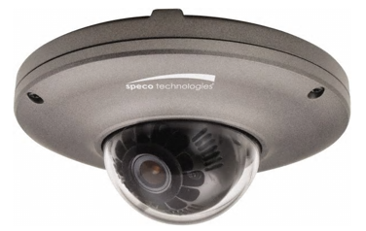
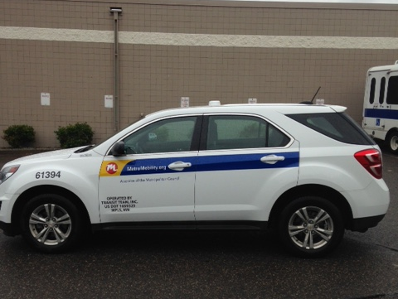
Fleet & Technology Profile
Revenue Vehicles- Council owned fleet
499 cutaway buses (lift equipped)
21 Minivans (Ramp equipped)
33 SUVs (ambulatory only)
76% of fleet are 2023 - 2025 newer vehicles
Contractor responsible for use and maintenance terms in contract
Average cost for a new 2025 bus $153,000
Budgeted 10% spares (minimum)
Retired after 5 years/ >175,000 miles per Council and FTA Policy
(Currently most buses retired >275,000+ miles- rectified by Q1 2025)
Information Technology
Trapeze scheduling and dispatch system
Mobile Data Terminals
External and interior cameras
Cubic fare collection system
Global Positioning System (GPS)
ARMER Radio System
Ubisense (Remote Gate Entry)

Slide 7
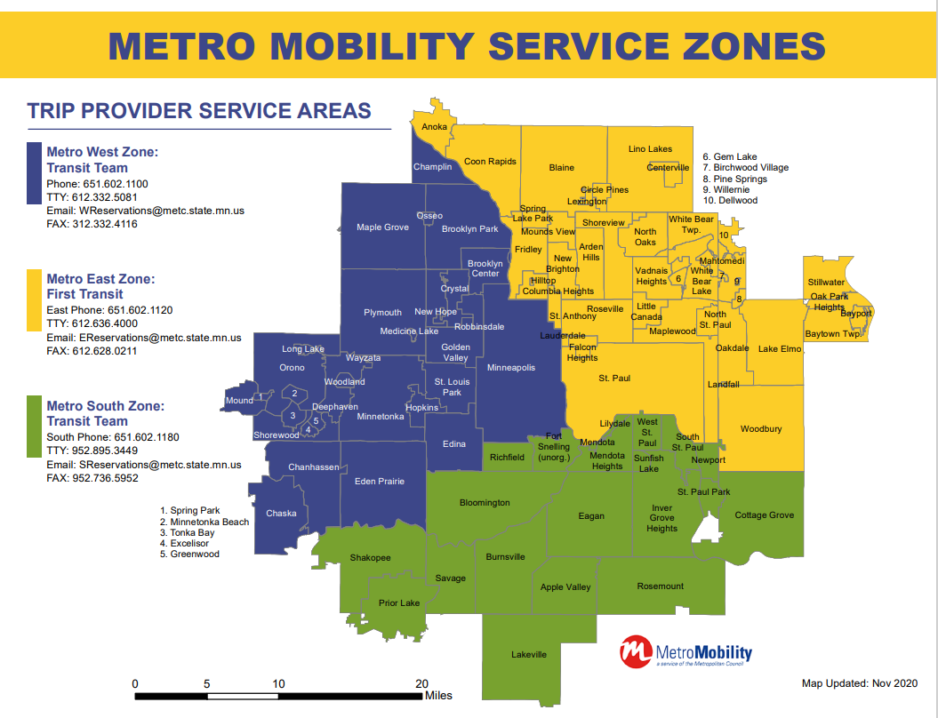
Service Contracts
  Demand West Zone (2021-2027)
  Demand East Zone (2021-2027)
  Demand South Zone (2020-2026)
  Premium On-Demand (taxi) (2025-2029)
    Transportation Plus
    Care Pool in the very near future
    Possibly one additional vendor to be added to this service

Slide 8
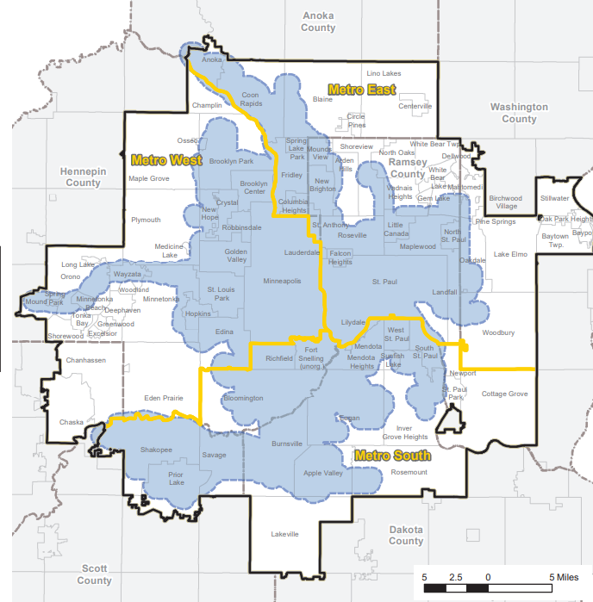
ADA vs. “non- ADA”
ADA service area (blue)
  FTA ADA mandated complimentary Paratransit
  Service provided within ¾ mile and similar hours of
  regular route bus or rail
  Enforced as a civil right by DOJ
  Subject to federal service quality thresholds
  Zero trip denials
Non-ADA service area (white)
  About 1/3 of rides provided
  Ride requests are placed on standby
  Not subject to federal rules around trip denials
Service areas and service hour adjustments perpetually under review

Slide 9
Key Service Performance Metrics
KPI | “ADA” Goal | “Non-ADA” Goal
OTP | 100% (contract min. 90%) | 85%
APPT | 100% (contract min. 85%) | 85%
OBT | 100% (contract min. 95%) | 95%
Denials | Zero | Zero
On-Time Performance (OTP): Percentage of all trips that arrive within 30-minutes of the negotiated pick-up time.
Appointment Time (APPT): Percentage of all trips that arrived no later than the negotiated appointment time and no earlier than 30 minutes early* to the scheduled appointment time. (*effective 1/1/2024)
On-Board Time (OBT): Percentage of trips that did not exceed the calculated maximum on board time.
Capacity Denials: Count of requested trips that were unable to be performed due to system capacity constraints.
NOTE: The Americans with Disabilities Act (ADA) does not permit transit agencies to have any capacity constraints in ADA paratransit. Capacity constraints are defined as any operational patterns or practices that significantly limit the availability of service to ADA paratransit eligible individuals.

Slide 10
2025 Year To Date KPI Data
All Trips
On Time Performance- 93.9% (2024 = 91.8%)
  (of 531,249 performed trips, 32,406 late pickups)
Appointment Time Performance- 93.9% (2024 = 89.2%)
  (Of 161,570 trips, 1,359 arrivals too early and 8,433 late arrivals)
On-Board Time Performance- 97.4% (2024 = 95.7%)
  (Of 531,249 trips, 13,812 rides too long)

Slide 11
2025 KPI Data
ADA Trips
On Time Performance- 94.0% (2024 = 92.0%)
  (of 383,284 performed trips, 22,997 late pickups)
Appointment Time Performance- 93.9% (2024 = 89.4%)
  (Of 109,575 trips, 922 arrivals too early and 5,719 late arrivals)
On-Bord Time Performance- 97.0% (2024 = 95.3%)
  (Of 383,284 trips, 11,499 rides too long)

Slide 12
2025 KPI Data
Non-ADA Trips
On Time Performance- 93.8% (2024 = 90.9%)
  (of 147,965 performed trips, 9,174 late pickups)
Appointment Time Performance- 93.9% (2024 = 88.8%)
  (Of 51,995 trips, 437 arrivals too early and 2,714 late arrivals)
On-Bord Time Performance- 98.3% (2024 = 96.8%)
  (Of 147,965 trips, 2,515 rides too long)

Slide 13
2025 KPI Data – Non-ADA Trip Denials
0 total one-way denials in 2025
111 total one-way denials in 2024 (almost exclusively in January)
10,726 in 2023

Slide 14
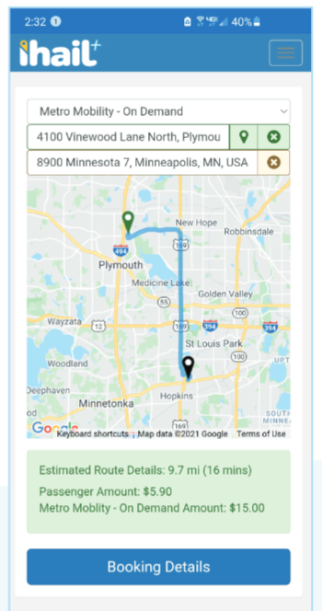
Premium On-Demand Service – Transportation Plus
  Taxi opt-in service since 2004
  14,320 rides through January of 2025 (46% increase over January 2024, w/ 505% increase in lift usage.)
  5-year contract with Transportation Plus (‘25-’29)
  Available to any certified Metro Mobility client
  Same service area and hours as Metro Mobility
  “Comparable” Wheelchair Accessible Vehicle (WAV) service required
  Council pays up to $20 per ride
  On-demand via customized ihail App
  Expands service throughout region with advance booking

Slide 15
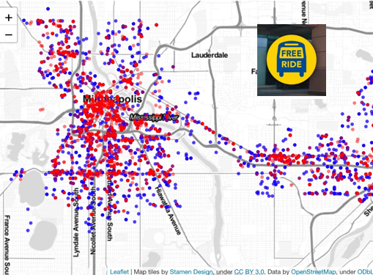
Temporary Pilots
Regular Route 1-Cent Fares (Jan 2025- Jun 2025)
  Metro Mobility Certified customers ride for 1-Cent on fixed route system wide
  May become permeant, may become free with legislative action.
Additional Premium on Demand service
  Legislatively mandated
  Allows for Metro Mobility customers who live in areas with truncated service hours to have a transportation option
  6am-10pm M-F, 7am-11pm Saturdays, 7am-10pm Sundays. End in June.
  Must be booked 1-4 days in advance
  Will have two providers for this service in the very near future!

Slide 16
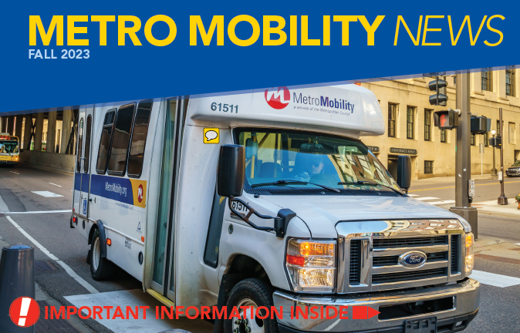
Customer Support / Stakeholder Engagement
Hard copy and digital subscription newsletters
Biannual Community Conversations -
Advocacy group outreach and listening sessions
Training partnerships
Transit Accessibility Advisory Committee
  - Metro Mobility liaison role
  - MTS Recording Secretary role
  - TAAC members regularly engage as subject matter experts and key stakeholders on MTS projects, including RFPs

Slide 17
Transportation Accessibility Advisory Committee
Created by State Statute 473.375
15 members + Chair
All aspects of fixed route and special transportation service accessibility
Advises Council on long-range plans to meet accessibility needs
Agenda and work plan set by TAAC chair
  Information items, report-backs on past topics or questions/follow-up
  Standing committee items on projects
1st Wednesdays 12:30-14:30; Meetings are open to the public
Held in Council Chambers at 390 Robert St N in Saint Paul
Membership | Appointed by
Chair (at large) | Council Chair
Community Members (8) | Met Council
2 members | MN Council on Disability
2 members | MN Area Agency on Aging
2 members | MN Consortium for Citizens with Disabilities
1 member | MN AARP
Ex-officio Members | Roles
Julie Sellner/Cheryl Schmidt | MTS
Doug Cook | Metro Transit
Vacant | OEEO ADA & Title VI Administrator
CM Cameron | Council Member

Slide 18
Member Questions
Driver Mate update? Drive Mate acts as an electronic manifest for drivers allowing for real-time scheduling and trip updates, and improved communication between drivers and dispatch. The tablets would replace Rangers currently being used in the vehicles. Currently working through technical and network issues. No Live date has been determined as of yet.
POD (Premium On Demand) update? Currently Transportation Plus, a new POD provider, Care Pool, should be in service very soon. Care Pool is in the start up stages of going live. Public notification will go out when the service goes live.
Other?

Slide 19

Thank you!

