Slide 1
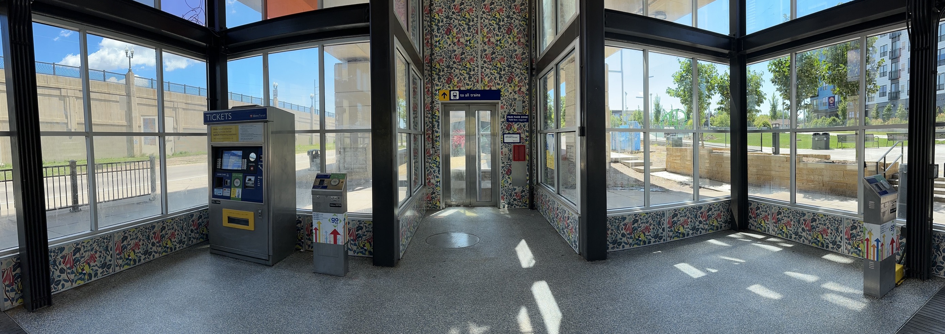

Blue Line Lake St/Midtown Station: TAAC Update
May 7, 2025
Christina Morrison, Metro Transit Engineering & Facilities
Notes:
I’m Christina Morrison, a principal project coordinator in Metro Transit Engineering and Facilities.
The photo on this cover slide is an interior view of Blue Line Lake St/Midtown Station from the perspective of a person approaching the elevator. The walls of the station have a floral “wallpaper” applied.

Slide 2
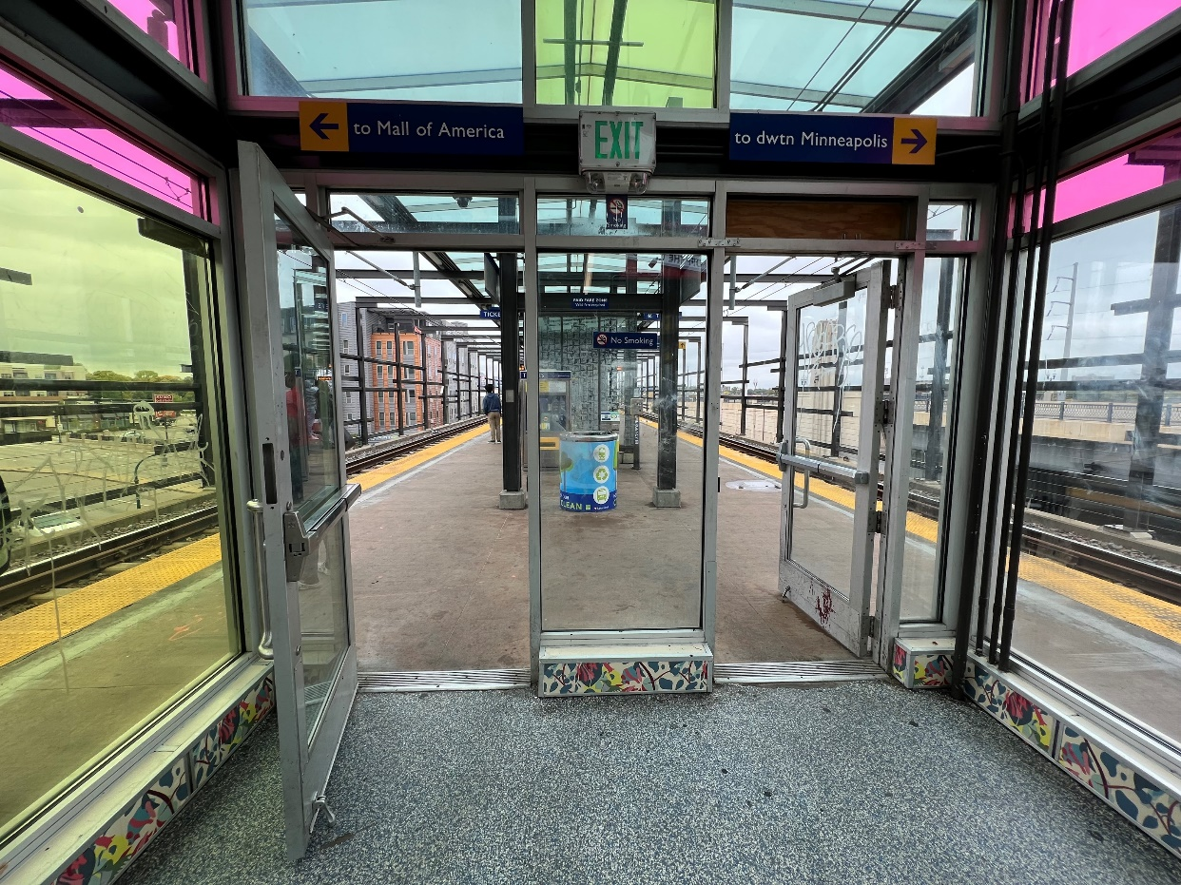
Renovation Project
Redesign scope includes:
  North and south tower lobbies including stairs and elevators
  Platform-level shelters, canopy, windscreen, and amenities
Goals:
  Provide reliable accessibility
  Reduce maintenance and enhance operations
  Improve customer experience
Approaching the existing platform from the escalator or stairs
Notes:
Renovation work is due as this station is over 20 years in service, and as a reminder, the scope will include the north and south lobbies that currently have stairs, elevators and escalators, as well as the platform level shelters, overhead canopy, windscreens, and customer amenities. The photo on this slide shows the view of the station platform when approaching the platform from the escalator or stair upper lobby.
The goals for the station renovation are to provide reliable accessibility to the station, reduce the daily maintenance required while enhancing how our staff can successfully operate here, and to improve the customer experience.

Slide 3
Project Timeline
Design
Planning
Purpose and Need
Construction
Lake St/Midtown Station
(2026-2027)
Concept design
Staff + TAAC meetings
Ramp concepts
Station design developed (2024-2025)
Public input
Staff + TAAC review
TAAC Update #1
May 2022
TAAC Update #2
May 2023
TAAC Update #3
December 2023
TAAC Update #5
May 2025
TAAC Update #4
September 2024
Notes:
This project started planning in 2022, and we’ve had periodic updates to this group since that time. Since our last visit in September, we’ve progressed the design to about 90% plans. Our last visit was around 30% so we have some updates to share on how things have shaped up
Construction for this station renovation will largely take place in 2026 and 2027.

Slide 4
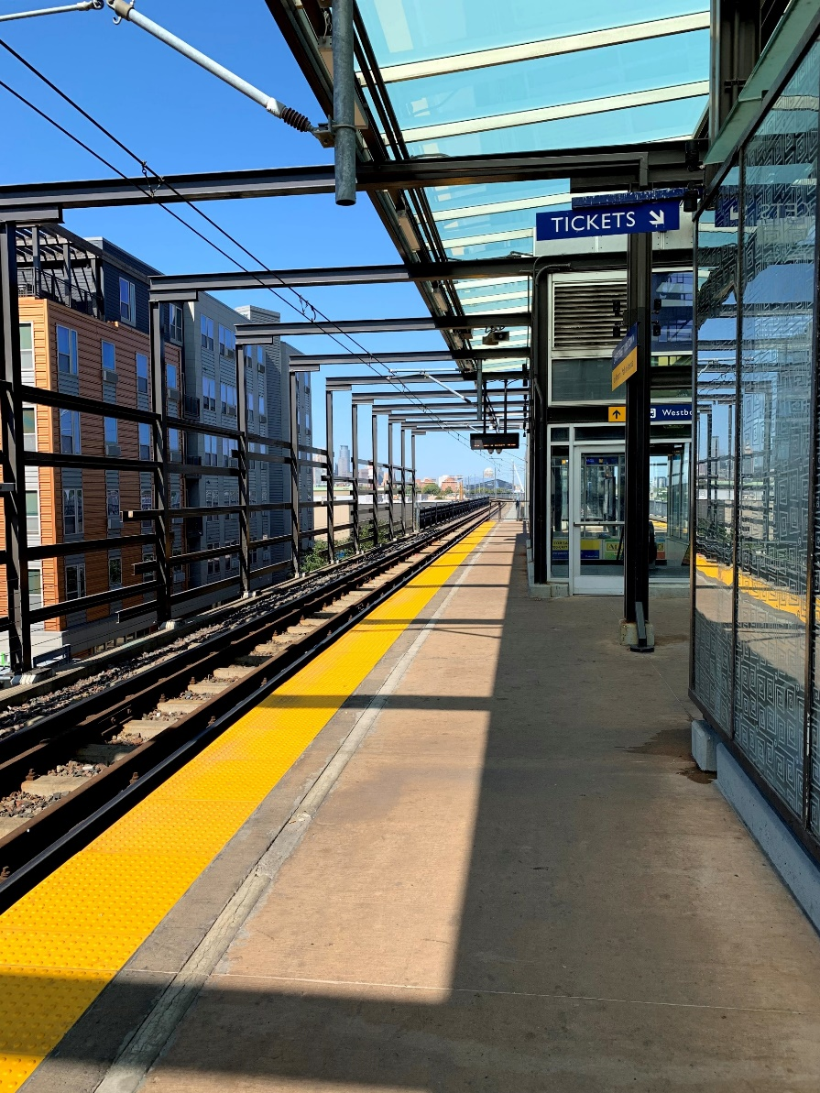
Today’s Discussion
February Open House feedback
Design progress
  Platform and canopy details
  Track crossing sightline improvements
  Simplified street level entrances
  Development of the ramp
Existing LRT platform with partial canopy and glass shelters
Notes:
Today we want to share some info on public feedback we’ve heard, and then talk about design topics including platform and canopy details, how we’ve modified the new track crossing, simplifying the street level entrance design, and further development on the ramp concept we previously shared.
The photo on this slides shows the view from the station platform with a partial glass canopy and glass shelters.

Slide 5
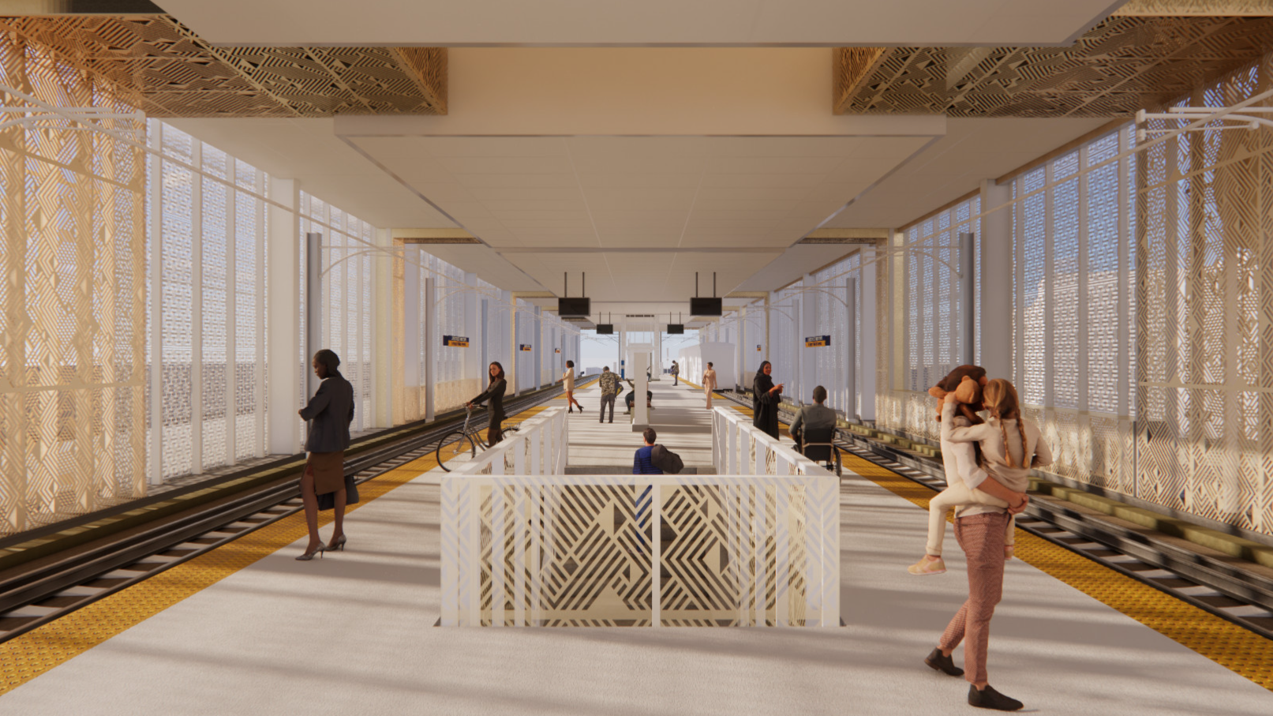
Open House feedback
We had an open house on February 11th
  50+ people in attendance
Key findings
  Support for continued use of 24/7 security, increased lighting throughout
  Appreciated the clear sightlines on the platform and the canopy coverage to protect from weather and provide shade
  Support for the proposal to add an outdoor public toilet in the plaza
  Concerns if metal paneling will adequately address wind and warmth, interest in improving heater options
  Concerns about construction duration and access to transit
Full report available at www.metrotransit.org/hi-lake
Planned LRT platform with metal paneling on the outside of the tracks and a full canopy
Notes:
We hosted our second open house in February and had more than 50 people attend, including Committee member Ken Rogers. Key things we heard at that open house include ongoing personal safety concerns and support for continued use of our supplemental security team, which is on site 24 hours a day, as well as increased lighting on both levels. We heard that people appreciated the clear sightlines on the new platform and a full canopy to protect them from rain and snow, as well as creating shade in our hot summers
We proposed and heard positive feedback about the idea of adding an outdoor public toilet in the plaza
We heard some concerns too – questions about mitigating weather – if the perforated metal screen would adequately block winds as well as an ask for better heater options for passengers waiting for a train. We also heard a lot of questions about the construction phase, not all of which we can answer yet, but a lot of interest in how people will access transit during construction.
The design rendering on this page shows the proposed center platform, clear of obstructions in the center, with perforated gold-colored metal panels on the outside of the tracks, and along the sides of the staircase. So we’re replacing glass that today breaks frequently with a more durable, long lasting material. A white canopy overhead stretches to the outside of the tracks. Passengers are waiting for trains.
If you’re interested in reading more about the open house, you can find a full engagement report at our website: metrotransit.org/hi-lake

Slide 6
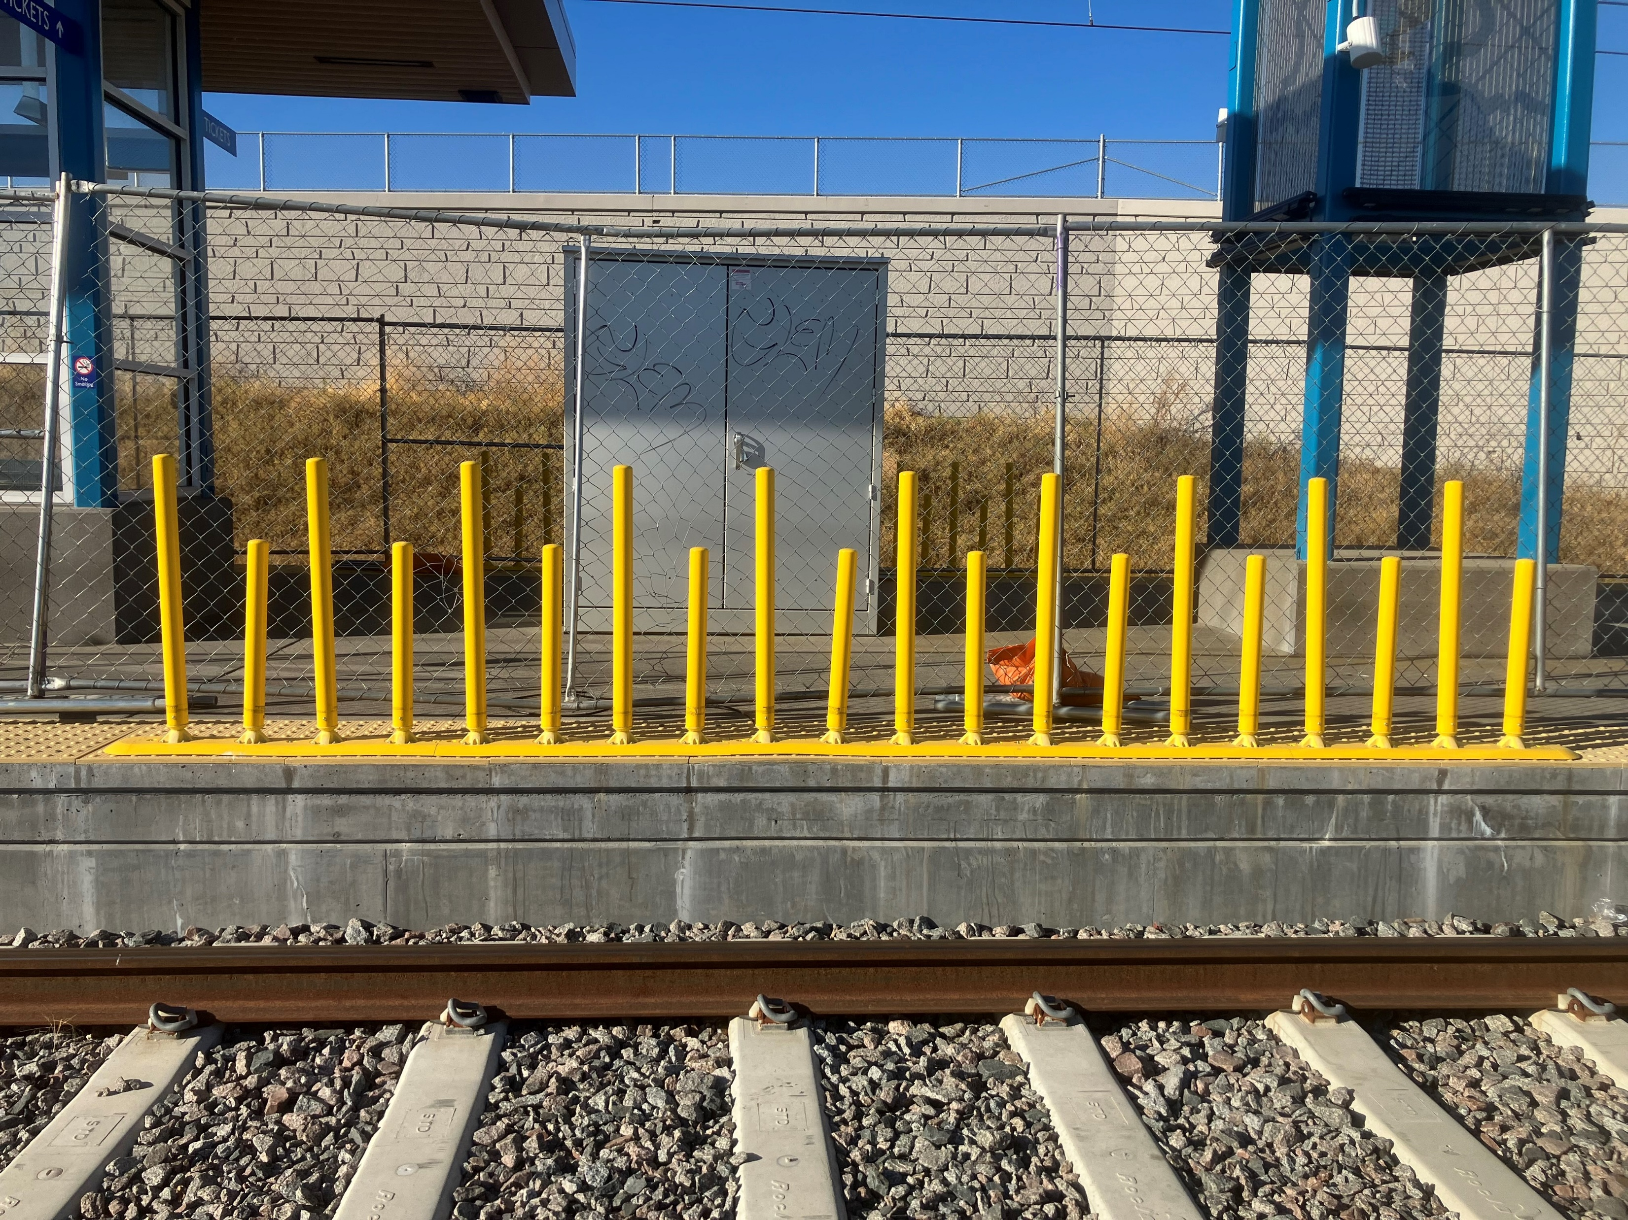
Platform
Identified clear door zones
  Bench placement between doors
  Between-car bollards and tactile doormats added
Replaced heated benches with pendant-style heaters
  Placed between benches
  Better serves all users, does not require sitting to access heat
Example of between car barriers installed on the Green Line Extension
Notes:
We’re continuing to refine the platform design for Lake Street, including being mindful of keeping the door areas clear for each train car, by doing things like placing benches between door areas, adding yellow between-car barriers on the edge of the platform, and adding tactile doormats at the front car of each train.
The photo on this slide is of between-car barriers already installed on the green line extension. These barriers are a series yellow vertical bollards of different heights, placed on the edge of the platform parallel to the tracks to warn people that space is between the train cars and not a door opening.
In response to public feedback we have also have eliminated the proposed heated benches, and we’re pursuing a hanging heater, more of a pendant style, that would better serve all users. The will not be placed over benches and unlike the bench idea, do not require sitting to use.

Slide 7
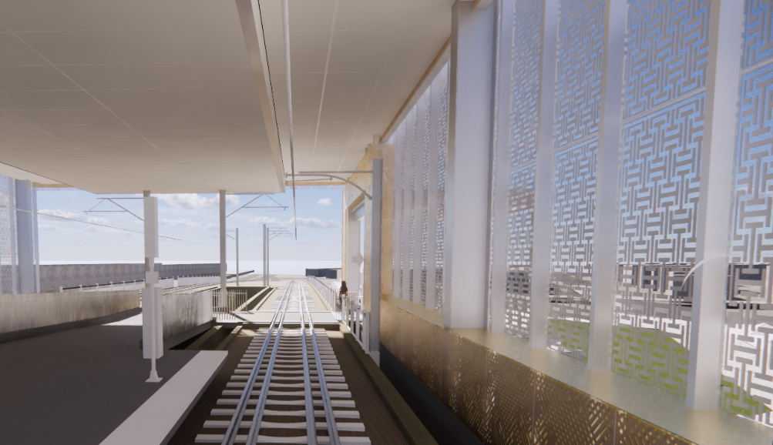
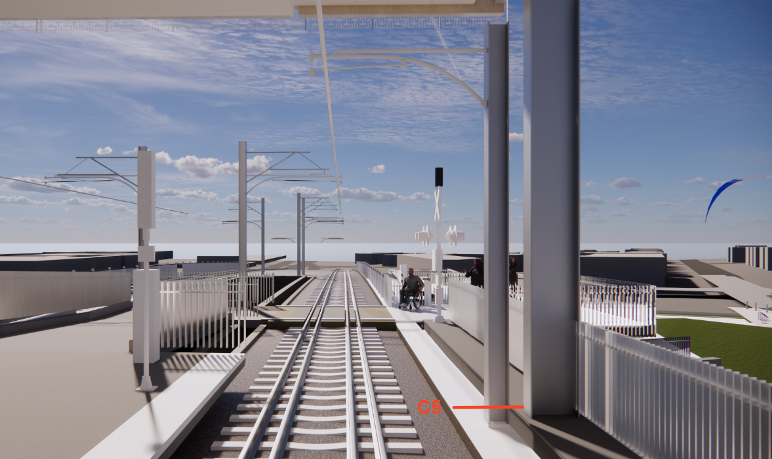
Track crossing
INITIAL DESIGN
Removed part of south end of canopy to open up sightlines for at the track-level crossing
  Eliminates vertical obstructions
  Improves sightlines of both riders and train operators
Both sides of the new track crossing will have truncated domes and standard warning devices
REVISED DESIGN
View of the new track level crossing from the train operator’s perspective
Notes:
One item that was flagged and redesigned since our last meeting is the relationship between the canopy and the track crossing. We had originally envisioned this as a covered crossing, but when we started looking at the model and the renderings it was clear that the structure needed to support that additional canopy was detrimental to sightlines of both users and train operators creating an unacceptable and unsafe crossing condition. By peeling back the canopy a little over 40 feet, we’re able to literally daylight that crossing and provide a direct line of sight. Both sides of the new track crossing will also have truncated domes and standard warning devices seen at other rail stations.
The first of these two images shows how in the initial design, the canopy and side panels obscured the view of the train operator, making the crossing hard to see, while the second eliminated the vertical obstructions and allows the train operator to view the passenger that is waiting to cross.

Slide 8
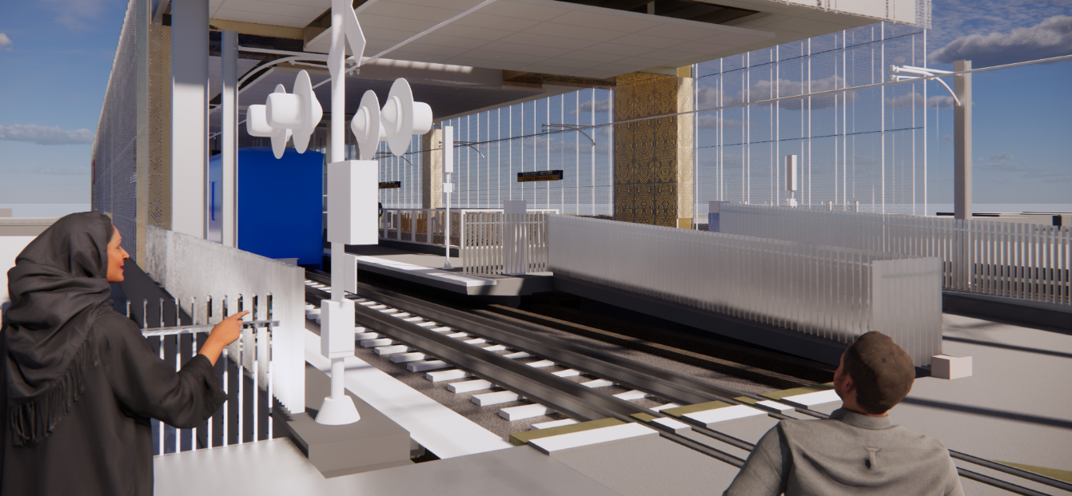
Track crossing from rider’s perspective
Notes:
This is the same design as the previous slide, but from the rider's perspective. The blue box represents the front of the train.

Slide 9
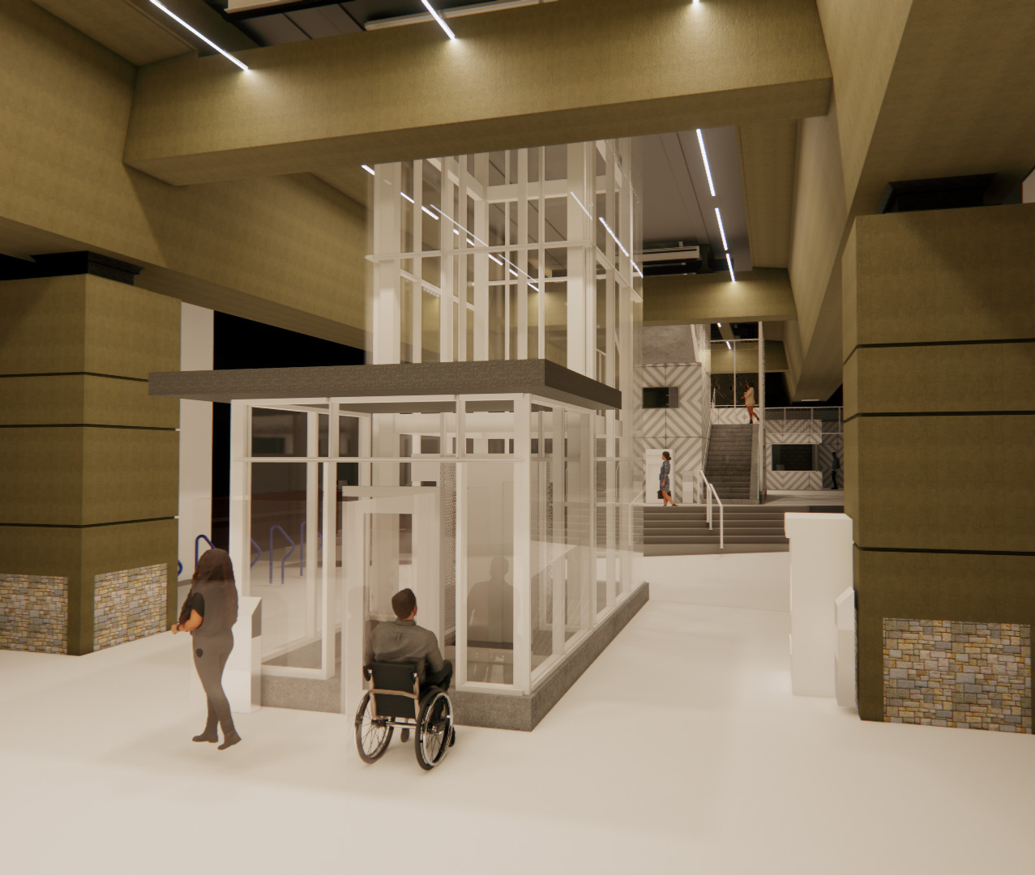
Street level
Simplified the edges of stairs on the plaza level
Adding real-time signs, public announcements at the street level
  Allows both audio and visual announcements about service, including notice of shutdowns or emergencies
More seamless access walk and roll access to the new Transit Service Center ticket windows
View of the elevator and stair entrances, from Lake Street looking south
Notes:
On this next slide, we’re talking about street level, and the rendering here shows the south entrance under the LRT bridge, looking from Lake Street, which includes an elevator close to the curb, facing the street, with a glass vestibule. Behind the elevator, there is a staircase up to the platform, and behind that staircase is the new Transit Service Center.
In our public feedback, we heard interest in simplifying the staircases/levels proposed to tie into the plaza.
We’re adding real time signs and a public announcement system at the street level that allows both audio and visual announcements about service, including notice of shutdowns or emergencies. For example, if the station is closed, you would not have to go up to the platform level to find that information out. That is an improvement as today we only have real time information and announcements on the platform level.
And by simplifying this area, we are providing more seamless to our new Transit Service Center ticket windows where we’ll have two staff providing transit information and where you can buy fare products

Slide 10
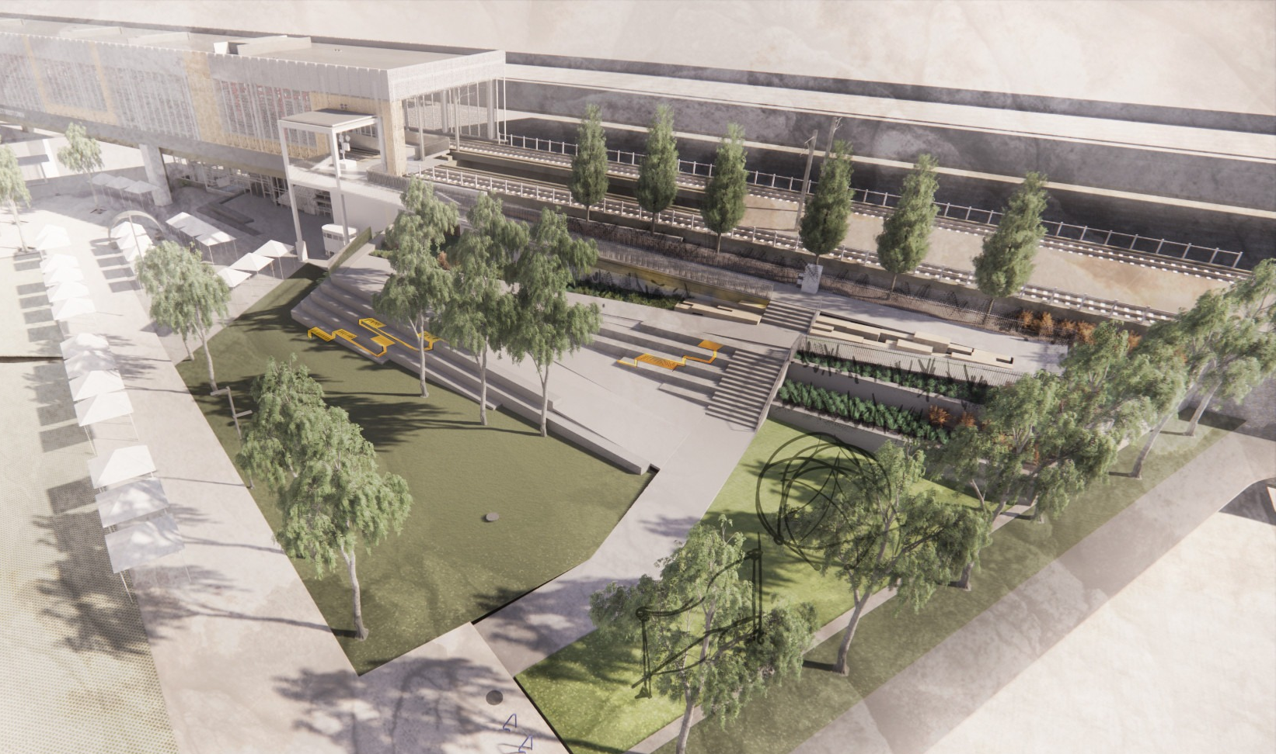
New pedestrian ramp
New ramp was approved by Minneapolis Park and Recreation Board
  Allows us to proceed with design and pursue easements with the Park Board for this permanent use at Market Square
Fully accessible slope, with underlit handrails and curb throughout
Will include snow melt for the full extent to facilitate quick and reduced snow maintenance
View of south station area with pedestrian ramp and adjacent park
Notes:
The next slide shows an updated rendering of the new pedestrian ramp on the south side of the station, accessible switchback from Market Square up to the platform, with seating and landscaping that integrates with the park. We’ve been working closely with the Minneapolis Park and Rec Board on the approval of this new ramp, which they did approve in February, and we continue working on the design, easements, and operations with park board staff.
This ramp is a fully accessible slope that will have underlit handrails, and we’re adding a small curb along the path to ensure the edges are easy to follow
This ramp is also planned to have a snow melt system, which will help to deter snow and ice, and facilitate quick maintenance

Slide 11
Construction approach and phasing
Construction is proposed to begin in Spring 2026 and be completed in 2027
  Coordinated with broader Blue Line shutdowns planned in both years
Longer closure of the station is being studied to greatly reduce duration, improve worksite safety
  Subject to rail operations approval
  Working within Metro Transit to discuss options and approaches for replacement bus service
Notes:
Finally, I wanted to give a preview of some of the construction approach and phasing, and this is very much still in development at Metro Transit working closely with Rail engineering and operations. Construction is proposed to begin in Spring 2026 and be completed in 2027, and that is being closely coordinated with broader Blue Line long-term shutdowns planned during both summers. A longer closure of the station is being studied to greatly reduce duration of the overall construction, and improve worksite safety on this aerial platform. That is currently under review and subject to rail operations approval. We are also working within Metro Transit to discuss different options and approaches for replacement bus service. I am hoping we will have more information on construction out to the public later this summer.

