Slide 1
Livable Communities Grants
TOD IN YOUR COMP PLAN
Metropolitan Council
January 26, 2017
Notes:
Hello, I am Erin Heelan, Program Officer for Met Council Livable Communities TOD Grants.
I am going to give a basic overview of the Livable Communities Grant Program, focus in on what make a successful TOD grant application, and where I see potential in comp planning to set your cities up for competitive applications later.

Slide 2
LCA Funding
The Tax Base Revitalization Account (TBRA)
The Livable Communities Demonstration Account (LCDA)
The Livable Communities Transit Oriented Development (TOD) Program
The Local Housing Incentives Account (LHIA)
Notes:
The Metropolitan Council offers several programs to assist communities with development projects.
The Tax Base Revitalization Account (TBRA) funds investigation and cleanup of polluted land and buildings for redevelopment that enhances the tax base while promoting job retention or job growth and/or the production of affordable housing.
The Livable Communities Demonstration Account (LCDA) funds public infrastructure and place-making for development and redevelopment that links housing, jobs and services, and demonstrates efficient land and infrastructure use.
The Livable Communities Transit Oriented Development (TOD) funding category funds public infrastructure and place-making for development and redevelopment around light rail, commuter rail and high frequency bus stations.
The Local Housing Incentives Account (LHIA) funds the development of housing that helps cities meet their goals of expanding and preserving affordable and lifecycle rental and ownership housing.
Met Council funding is only available to LCA participating communities within the seven county Metropolitan region. TBRA, LCDA, and TOD programs are applied for, awarded, and administered through Met Council Community Development Division. The Local Housing Incentives Account works in conjunction with MHFA’s Super RFP process
LCA Staff are available to meet with prospective grantees anytime throughout the year to discuss potential applications.

Slide 3
2016 Funding Opportunities
TBRA | LCDA | TOD
$5 Million | $7.5 Million | $5 Million LCDA $2 Million TBRA
LCA participating cities, HRA’s, EDA’s, port authorities
Affordable, market rate, or mixed income housing
Environmental site Assessment Soil or Ground Water Cleanup Soil vapor mitigation Asbestos or Lead-based Paint abatements | Acquisition Basic public infrastructure Placemaking (i.e., public elements that improve the functional connectivity) | All LCDA and TBRA grant activities Predevelopment Development of zoning implementation tools
LHIA
$2.5 million
Preservation or expansion of SF and MF affordable housing
Gap financing including acquisition, site preparation, general construction
Notes:
The information on this slide reflects our 2016 funding cycle… it is likely that their will not be significant changes for 2017. Our Fund Distribution Plan will likely be approved by our Council in March.
From top to bottom of the slide you can find the following:
-Program Type
-Funding available
-Who is eligible to apply
-Eligible housing types
-and the eligible uses for the funding
-LCA participating cities, HRA’s, EDA’s, and port authorities are eligible to apply and funding may be used for affordable, market rate, and mixed income housing projects. Eligible entities typically partner with developers on applications.
-Eligible uses vary based on grant program but generally:
TBRA is primarily used for site investigation or cleanup activities
LCDA funding is for site acquisition, public infrastructure, and placemaking related to development projects
TOD funding is available for the same activities as in the TBRA and LCDA programs, but within defined transit areas. Additionally, predevelopment funds are available for TOD projects.

Slide 4
Successful TOD Applications
TOD Design/Demonstration
Catalyst
Readiness
Notes:
Since this is a TOD workshop on this slide I am only highlighting the TOD criteria for competitive applications.
TOD applications should be located in an eligible station area AND:
-Clearly demonstrate the need for grant funds; the project should pass the “but for” test
-The project should include high quality TOD design, a variety of housing densities, types & costs, creative placemaking, environmentally sensitive development, and compact land use.
-The project should have the ability to catalyze additional development and be ready to move forward and be completed within a 3-year grant term.
_________________________________________________________
We want to see intention TOD Design. This should include:
Close Proximity to Rail Station (quality of walk to station)
Density (Housing and/or Jobs)
Mix of Uses (Horizontal and Vertical)
Pedestrian Scale
Active Ground Floor
Reduced, Shared, and Hidden Parking (including bike and car share amenities)
Well Defined Public Spaces
LCA TOD Handbook: http://metrocouncil.org/Communities/Services/Livable-Communities-Grants/Maps,-forms-misc/LCA-TOD-Handbook.aspx
If the project does not include these features but is in the station area it may be a better fit to apply through the regular LCDA program.

Slide 5
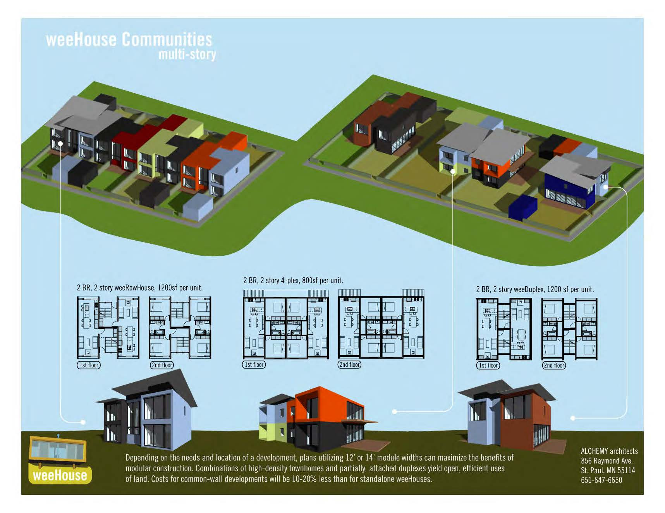
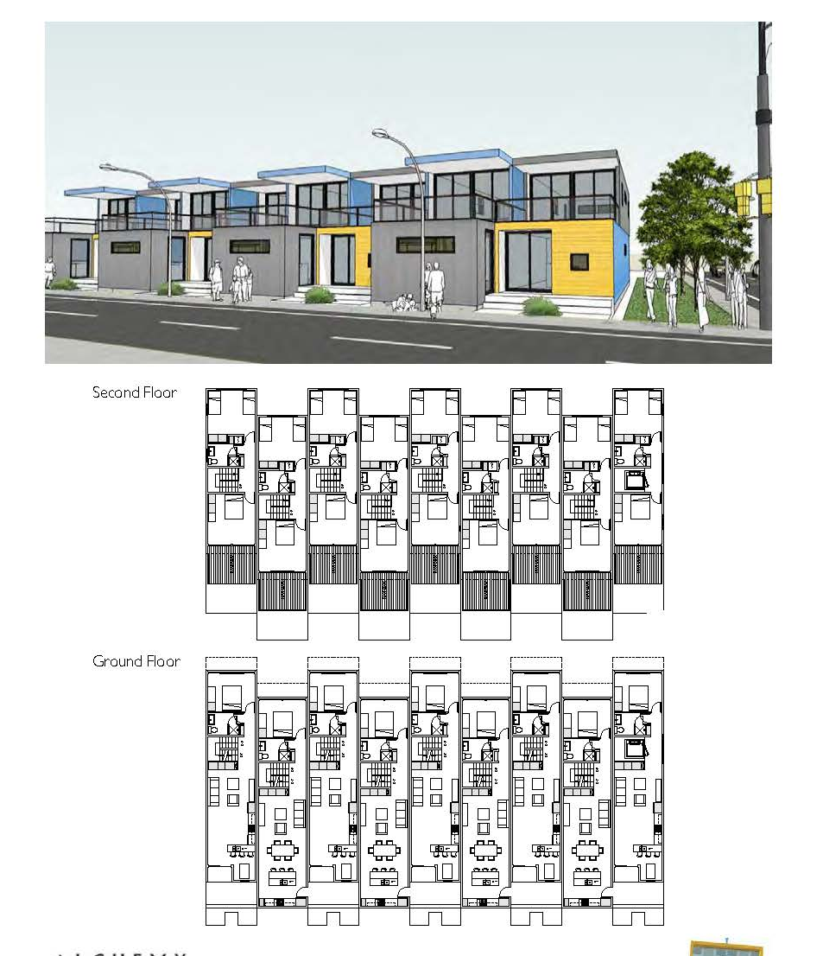
St. Paul - WeeHouse
TOD Predevelopment and Zoning
Notes:
Next, I am going to show you three examples of past successful TOD applications.
In Fall 2015, the Met Council awarded the City of St. Paul Wee houses project two grants totaling $100,000. In partnership with Eastside Neighborhood Development Center (ESNDC), and Robert Engstrom Companies the City of St. Paul applied for a predevelopment and a zoning implementation grant to assist with a 36 unit “tiny house” pocket neighborhood to East St. Paul. Although, this isn’t your typical TOD project, it scored well because it incorporates several TOD design features such as low parking ratios, efficient land use, and a mix of uses AND it demonstrates a new housing type for St. Paul.
____________________________
The project includes design of a small scale pocket neighborhood on a transit corridor and will link residential, transit, community space, and commercial space. The applicant will build a scale of housing that is affordable and sustainable because of unit size, delivery methods, and design efficiencies. They are exploring 36 total units of housing (35 – Ownership 1- Rental).
$50,000 for project predevelopment design work and the Council also approved $50,000 under our zoning implementation category for 1) adjusting zoning designations on traffic corridors, and 2) creating a Cluster Home zoning overlay that provides credit allowances in density (car/housing unit ratios, affordability, housing unit size, etc.), & built in variances on setbacks, hardcover, FAR, etc. The project intends to identify and remove obstacles in the St. Paul zoning code that prevent innovative TOD design projects. This will include revising the Cluster Home zoning overlay with new guidelines and controls that promote affordability, reduced parking ratios, car sharing, transit use, and increased densities.

Slide 6
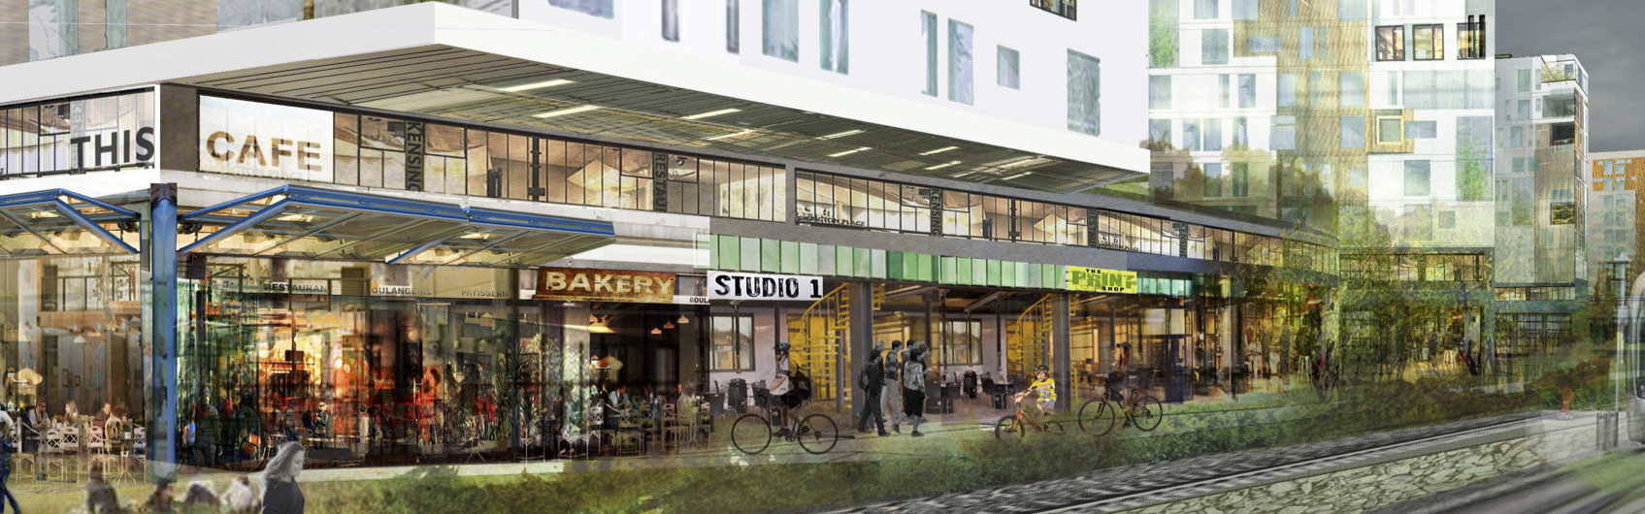
St. Louis Park - PLACE
TOD DEVELOPMENT
Notes:
Another successful past application was the St. Louis Park project PLACE. The project includes a 300 unit apartment project with 200 units affordable to residents earning <60% of AMI. The project will turn vacant industrial sites into a mixed-use, mixed-income community that includes a mobility hub, urban agriculture, makers space, live/work, a hotel, and renewable energy generation including anaerobic digestion of food waste.
The Council awarded $2 million in funding to support site acquisition, energy efficiency and stormwater management improvements.
This project is a model for the redevelopment of difficult “island” or remnant parcels near transit lines.
The project incorporates multiple modes of transportation (walking, biking, car-share, bus and LRT) and includes a mobility hub with concierge to encourage use and access.
The project includes alternative renewable energy system including anaerobic digestion, urban agriculture, a solar path and an innovative storm water management
The parking structure will be designed for easy adaptation for alternative future use
_______________________________________________
DEMONSTRATION:
What makes this project special? Why is it more than just an apartment building? How does it contribute to the overall livability of the neighborhood? City?
Does it expand neighborhood housing choice?
Does it include innovative green technology?
Does it fulfill a need identified within the station area plan?

Slide 7
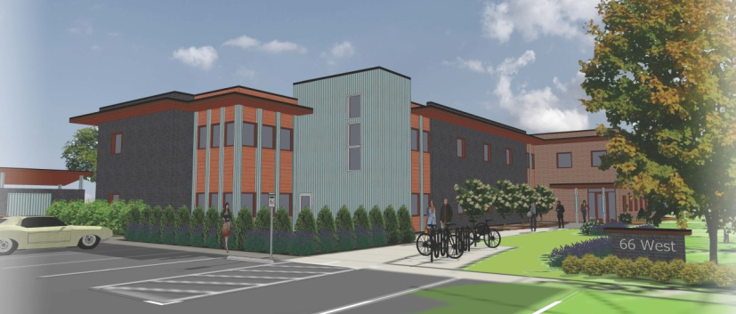
Edina - 66 West
TOD Development
Notes:
My last example is Edina’s 66 West. The project includes the redevelopment of a former bank branch building into permanent housing with intensive services for 39 young adults, ages 18-24, who are experiencing homelessness, 21 of whom have experienced long-term homelessness. Again, not your traditional TOD project, however, it is a good fit with the TOD program because the population it serves is transit dependent and the project location was selected based on it’s proximity to transit, jobs, and educational opportunities.
The Council recommended $900,000 for site acquisition. The projects demonstration value includes:
-Innovative partnership model between city, developer, and local congregations.
-Innovative reuse of a former commercial building.
-Potential to catalyze similar supportive housing projects in other suburban communities.
_________________________________
CATALYZE:
Will this project catalyze additional development within the station area?
Will this project catalyze innovative demonstration projects throughout the region?

Slide 8
Comp Plans and LCA Grants
Community Engagement
Energy Efficiency, Stormwater Management
Efficient Land Use, Urban Design
Housing Diversity, Housing Choice
Equity, Gentrification Considerations
Connections to transit and parks
Notes:
An important component of a successful proposals is how well the project aligns with City priorities, policies, and past planning efforts. We want to see cities using these grants as tools to help realize community goals, reward cities for having created policies that make sense for their communities, and push developers to create developments and redevelopment that add value above and beyond a traditional development project.
These are the areas that I could identify where front end policy work could help guide development that aligns with Livable Communities Goals:
Community Engagement
Energy Efficiency, Stormwater Management
Efficient Land Use, Urban Design
Housing Diversity, Housing Choice
Equity, Gentrification Considerations
Connections to transit and parks
The outcomes will look different in every community and therefore successful applications look different based on the community… some communities may be expanding multi-family affordable housing, others may include adding district energy to serve multiple development projects, another city may want to add an amphitheater and public plaza to create a focal point of a development. The most competitive applications we see reflect innovative policy and planning by City Staff on the front end AND the ability for City Staff to hold developers accountable to these policies during implementation.
____________________
Community Engagement – Are their innovative partnerships or do you require community benefits agreements?
Energy Efficiency and Stormwater Management – Does your City or Watershed have requirements for stormwater management?
Efficient Land Use and Urban Design – Do you offer density bonuses?
Housing Diversity, Housing Choice – Do you have an inclusionary housing policy?
Equity and Gentrification Considerations – Do you have a policy to address gentrification?
Connections to transit and parks - Do you have a complete streets policy?

Slide 9
Staff Contacts
Paul Burns, LCA Manager, 651-602-1106 Paul.Burns@metc.state.mn.us
Erin Heelan, LCA-TOD Program Coordinator, 651-602-1633 Erin.Heelan@metc.state.mn.us
Marcus Martin, TBRA Program Coordinator, 651-602-1054 Marcus.Martin@metc.state.mn.us
Ryan Kelley, LCDA and LHIA Program Coordinator, 651-602-1541 Ryan.Kelley@metc.state.mn.us
Notes:
Again, LCA Staff are available to meet with prospective grantees anytime throughout the year to discuss potential applications. Our contact info is on the slide.
Our next application deadline, pending fund distribution plan approval, will be May 1st if you have projects you are thinking about applying for in 2017 I would love to hear from you sooner rather than later.

Slide 10
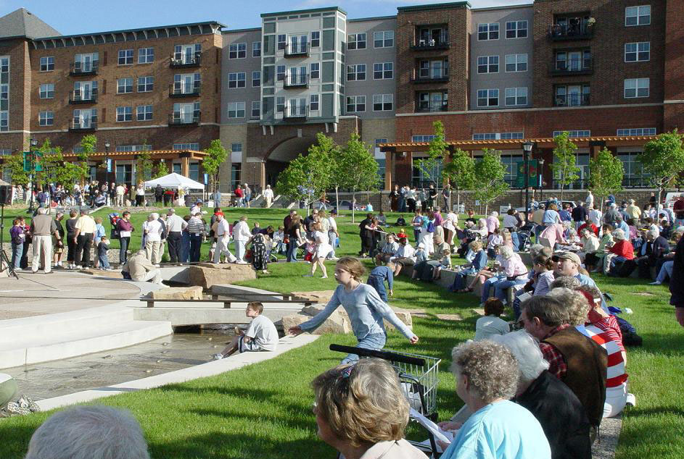
Livable Communities Programs Website:
http://www.metrocouncil.org/Communities/Services/Livable-Communities-Grants.aspx?source=child

