Slide 1
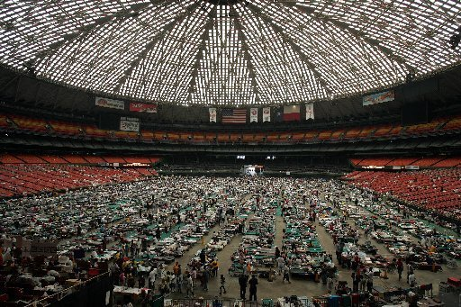
Climate Justice
Communities of color run the greatest risk of suffering from climate change.
If equity is not the focus of climate change policy, these communities will be entirely displaced by the combination of environmental change and systemic inequality.
Notes:
Simran

Slide 2
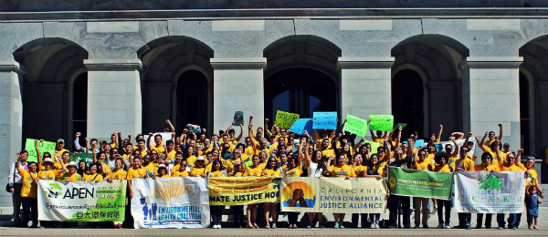
Environmental Justice
The fair treatment and meaningful involvement of all people regardless of race, color, national origin, or income with respect to the development, implementation, and enforcement of environmental laws, regulations, and policies.
Notes:
Simran

Slide 3
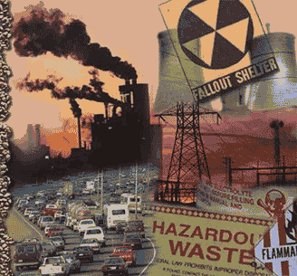
Environmental Conditions and Race
56% of residents near hazardous waste facilities are people of color*
Safe water supply and waste disposal facilities lack in about 12% of Native American homes compared to 1% of other U.S. homes**
*”Unequal Health Outcomes in the United States” CERD Working Group on Health and Environmental Health Report on Healthcare . January 2008
** Indian Health Service “Facts on Indian Health Disparities”, January 2006.
.
Notes:
Because of how we’ve constructed our communities (racially and economically segregated) people of color tend to be in environments that lack important health infrastructure (grocery stores, open space) and are exposed to environmental hazards (pollution)
3

Slide 4
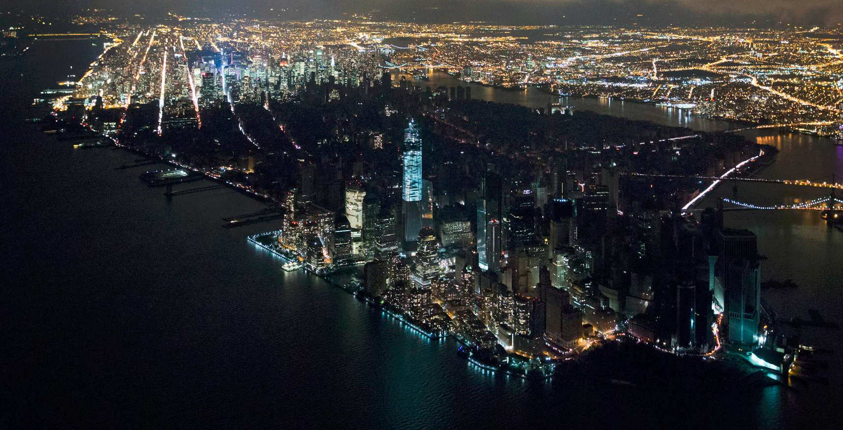
Equitable Resilience
“Risks and opportunities are not equally shared. The affluent are well-positioned to .. shield themselves from harm, while the disadvantaged face disproportionate risks. These dynamics are self-perpetuating: the affluent consolidate their gains while the poor fall farther behind.”
Notes:
Simran

Slide 5
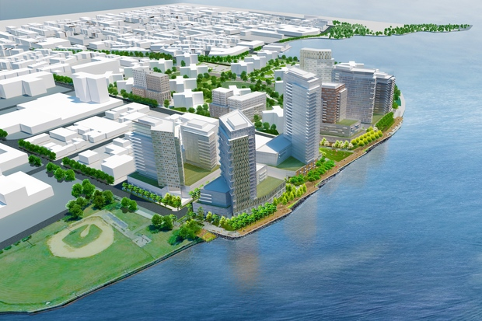
Displacement and Gentrification
Climate change causes the cost of living to increase
Green development is funded by private development, which causes more displacement
Environmental gentrification leads to inequality in access to housing
Notes:
Simran

Slide 6
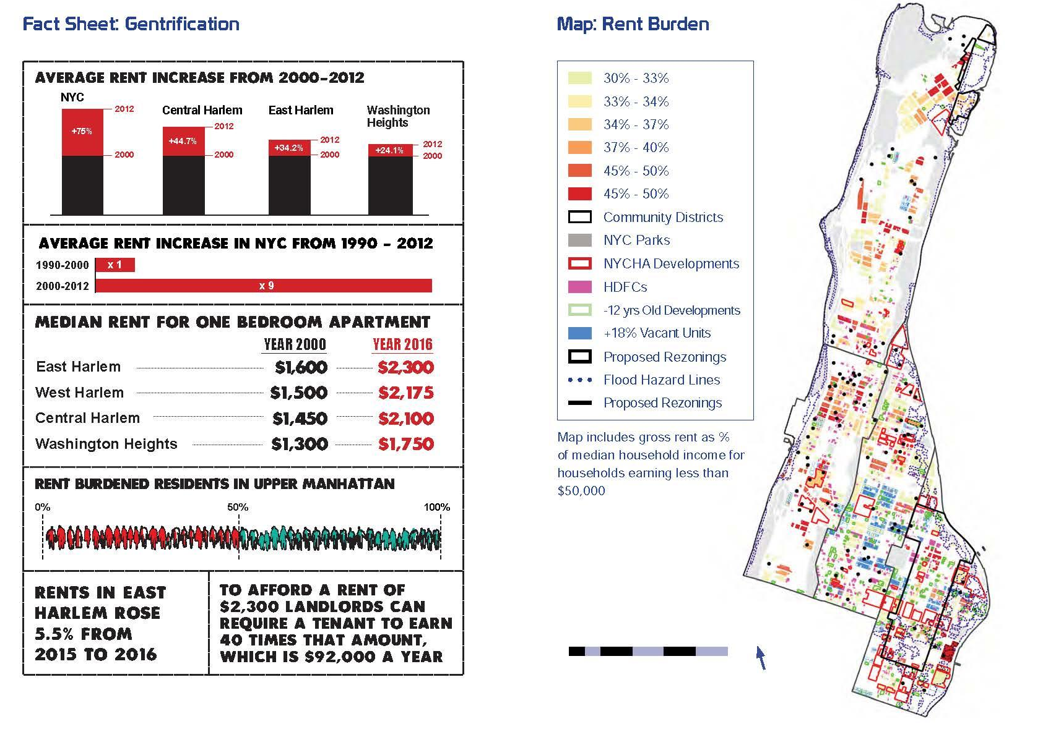
Displacement and Gentrification
Notes:
Simran

Slide 7
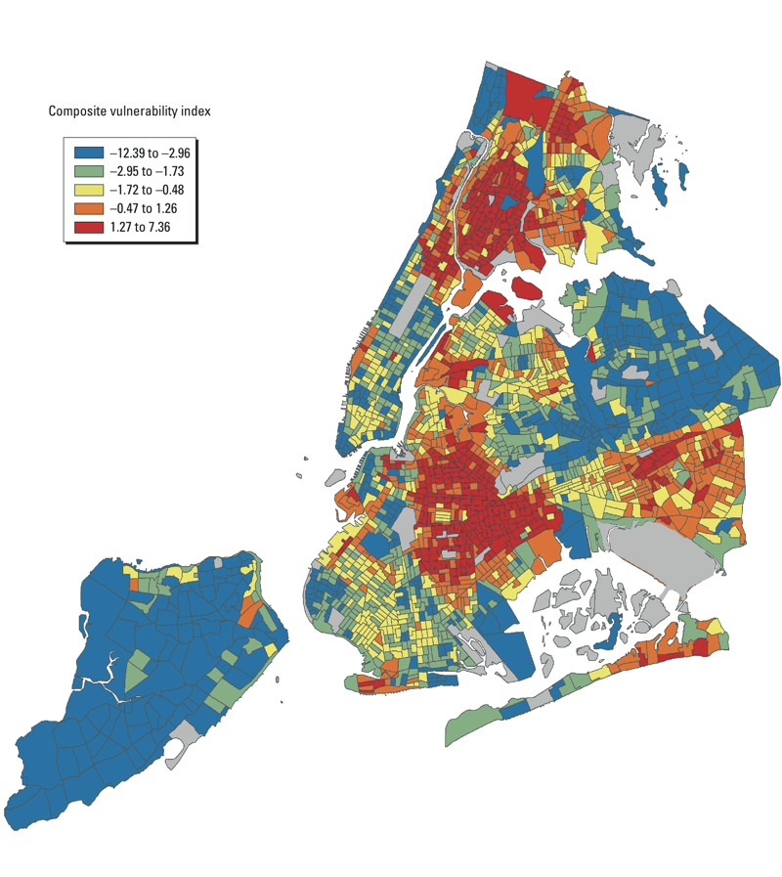
Vulnerability Mapping
Average Income
Housing insecurity
Access to transportation
Energy poverty
Food resources
Elderly populations
Race/ethnicity
Flooding
Urban heat island
Notes:
Simran

Slide 8
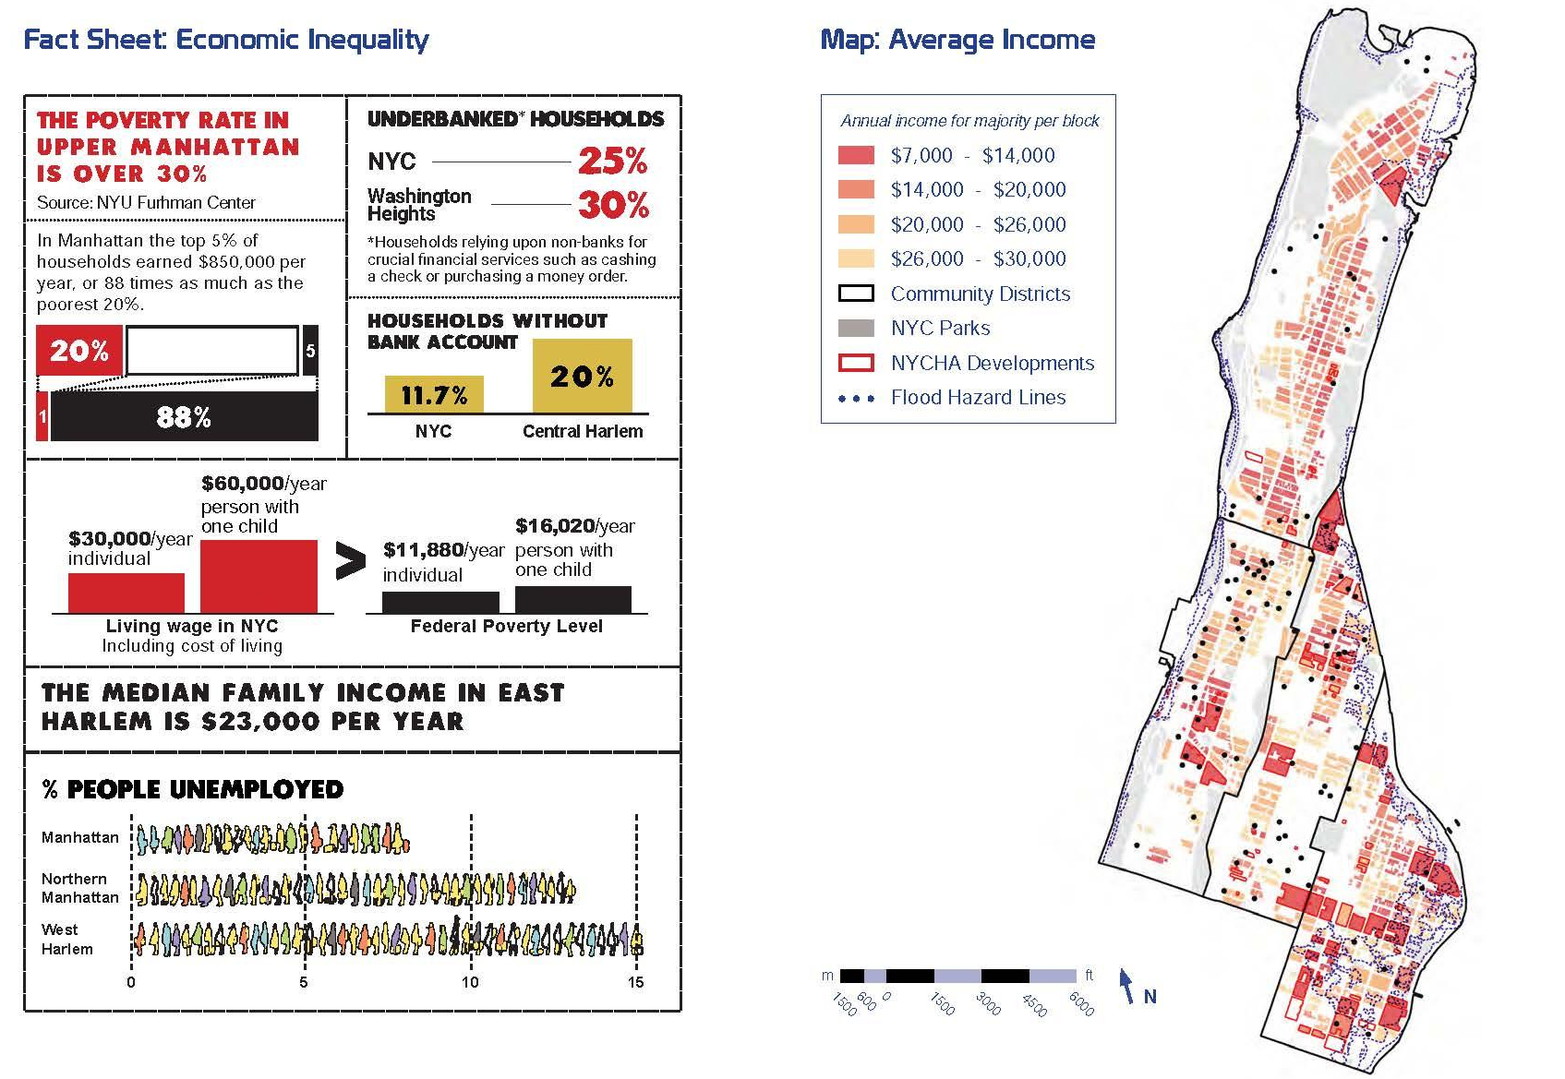
Vulnerability Mapping
Notes:
Simran

Slide 9
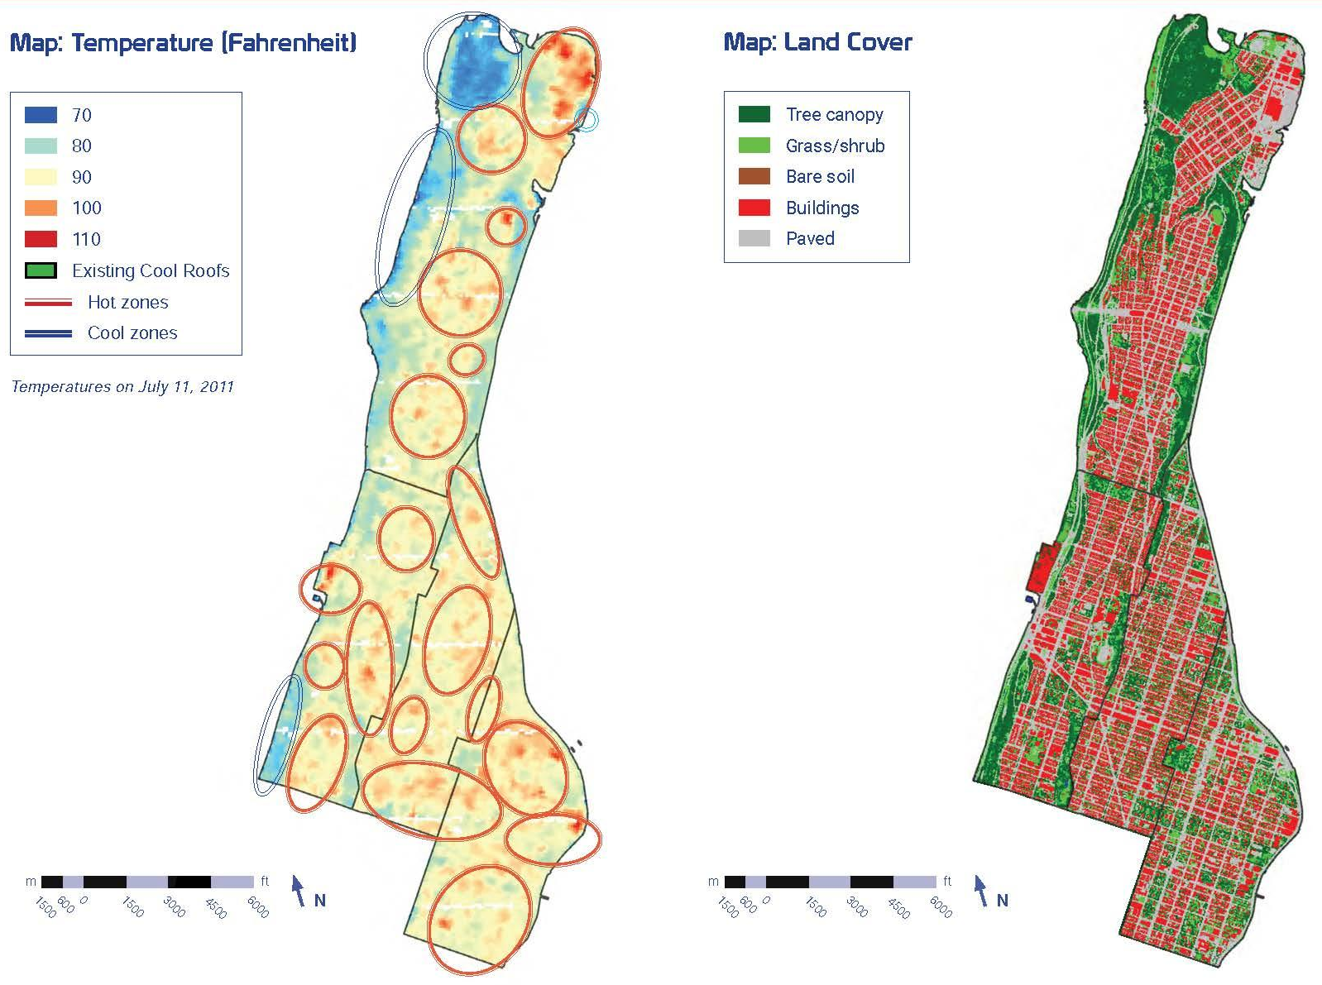
Urban Heat Island
Notes:
Simran

Slide 10
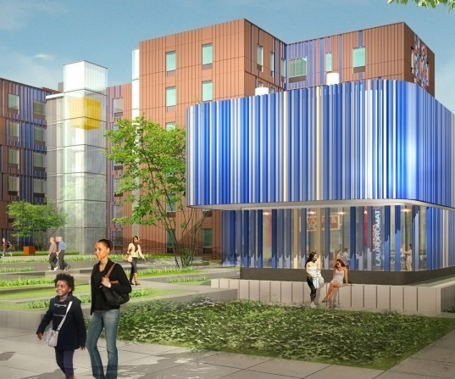
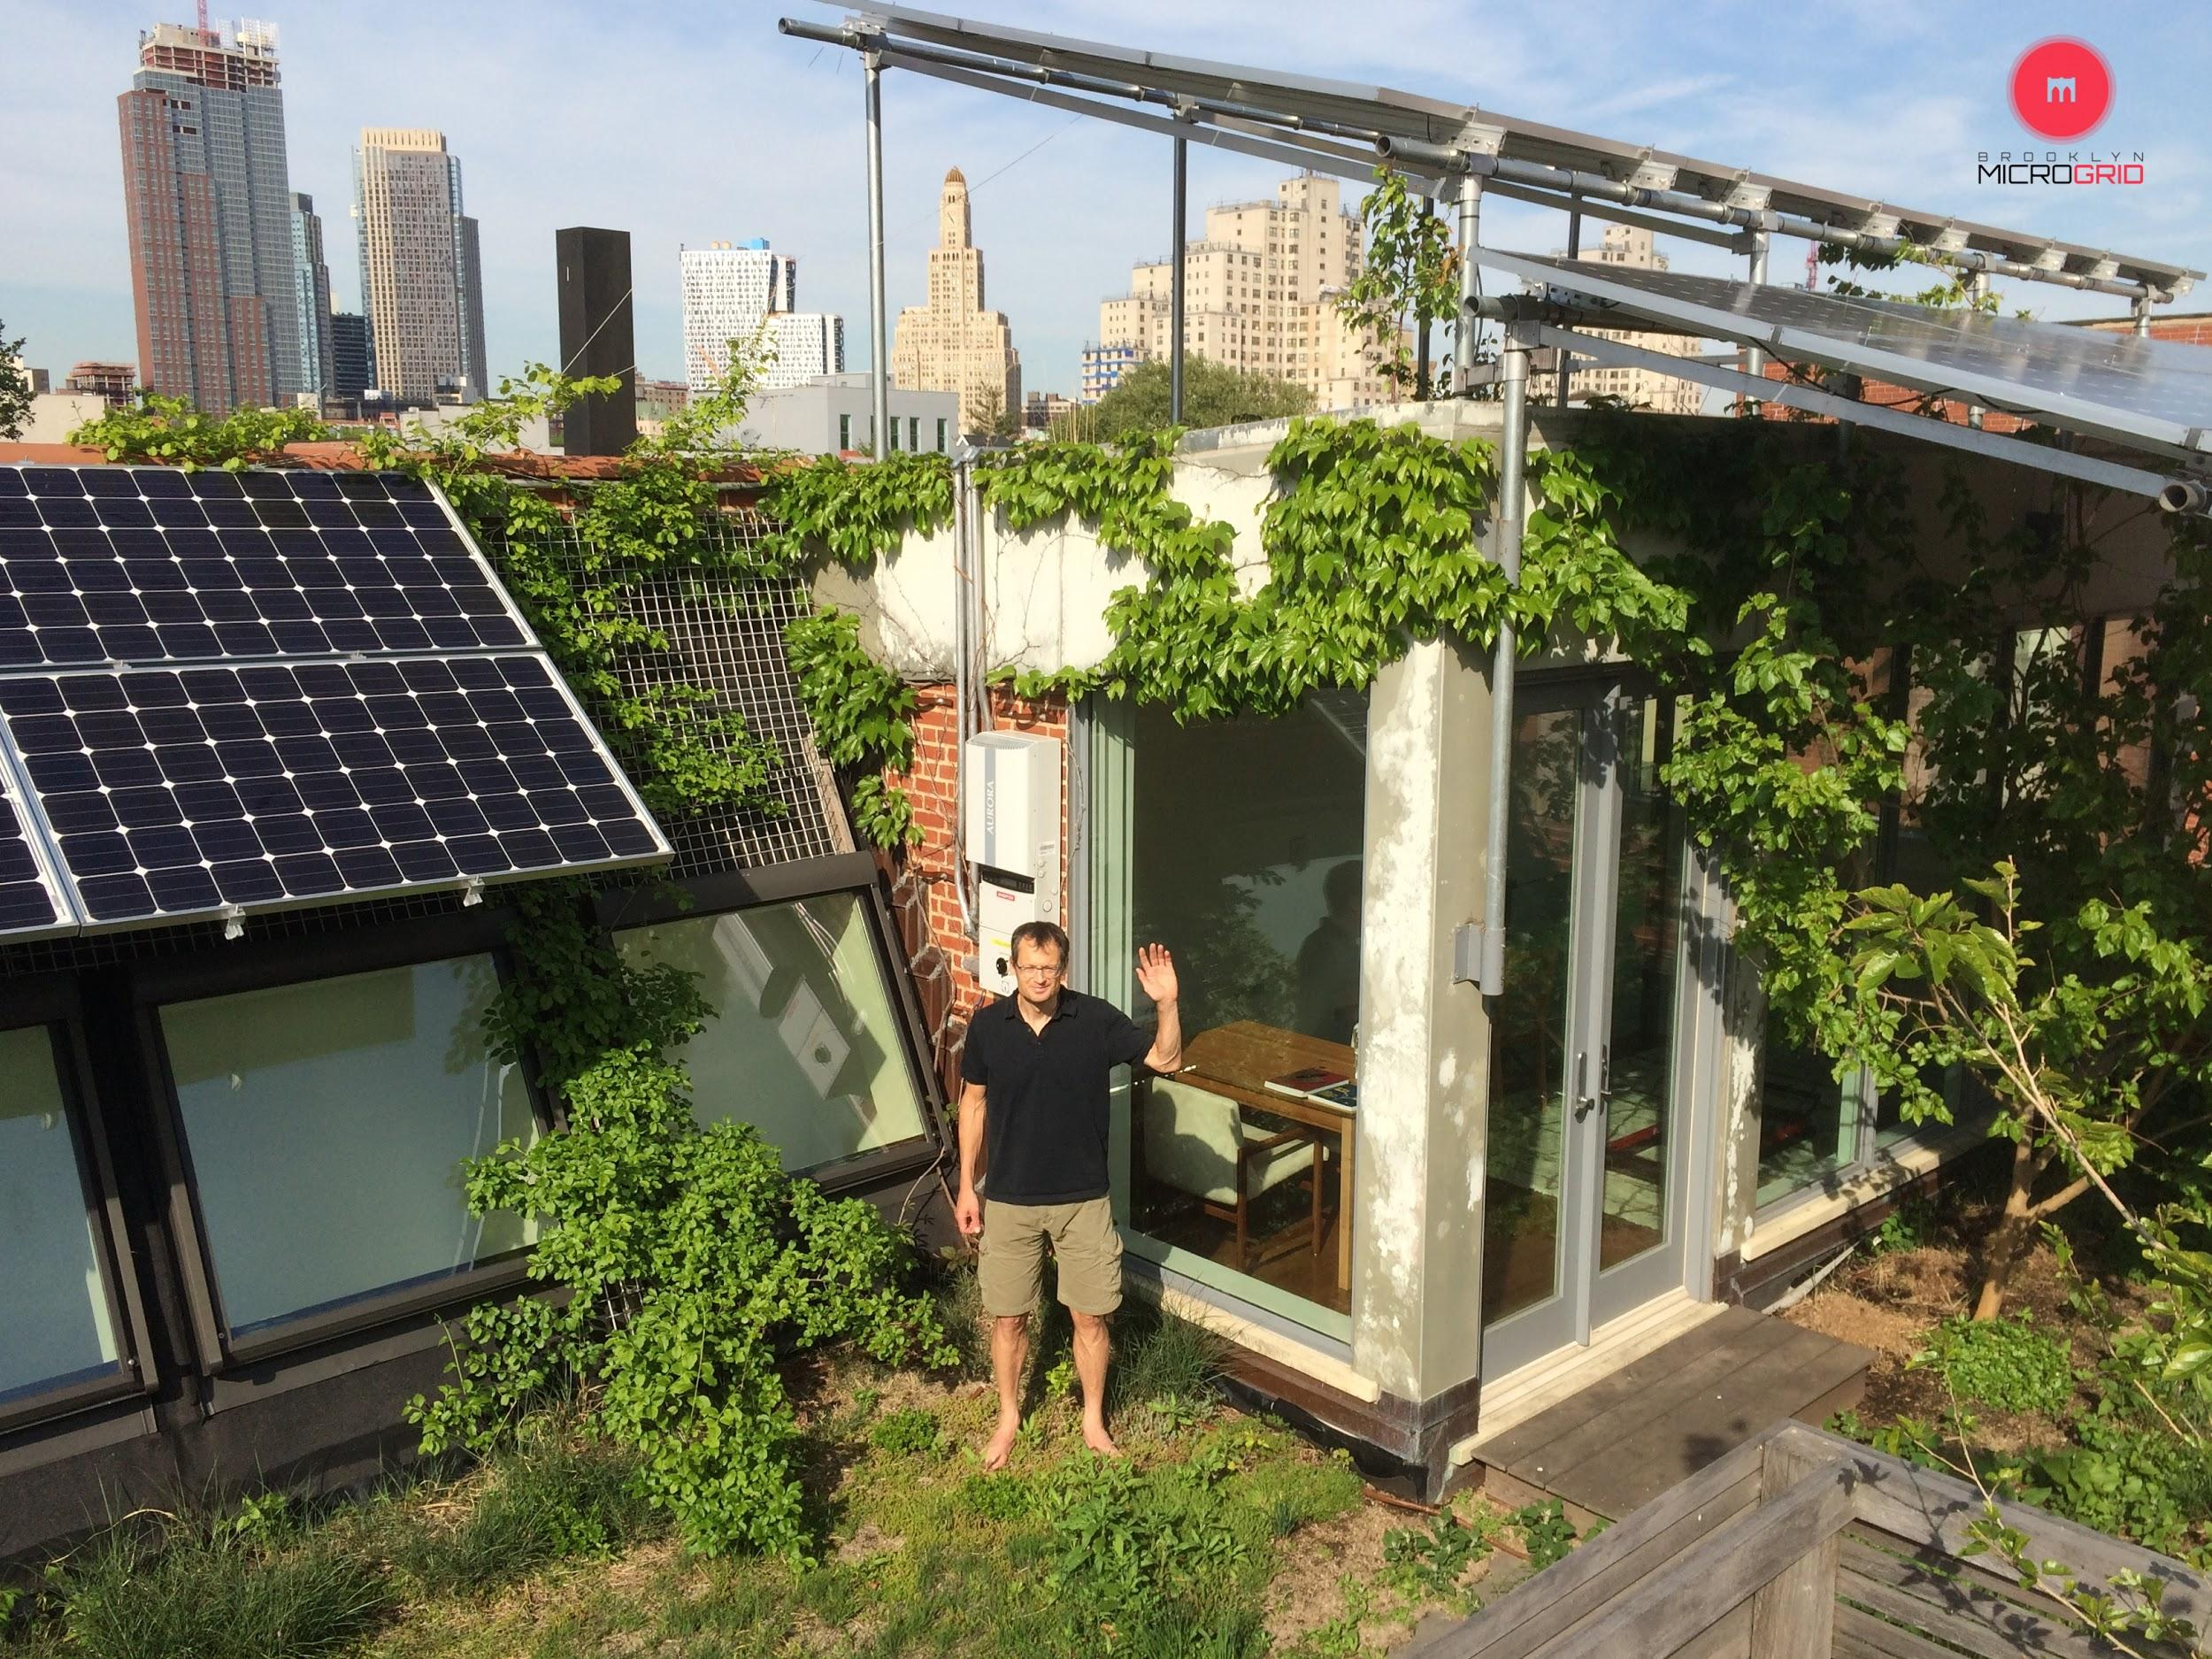

Energy Democracy
Residents have the right and authority to determine their own energy future
Vulnerable populations are protected
Local environmental quality is protected
Local businesses are supported
Notes:
Simran

Slide 11
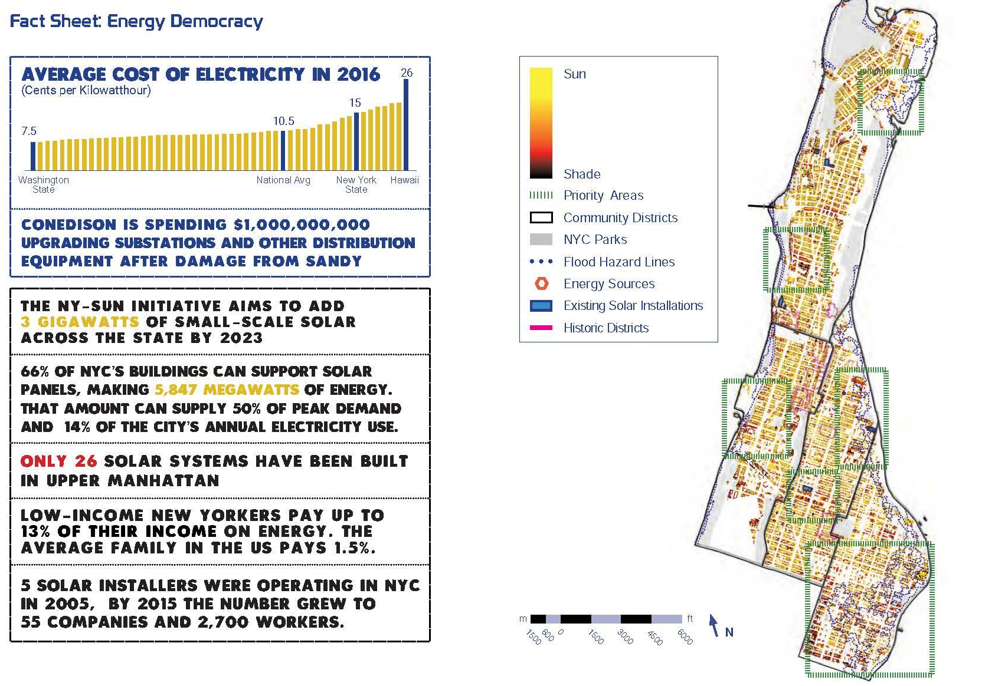
Energy Poverty
Notes:
Simran

Slide 12
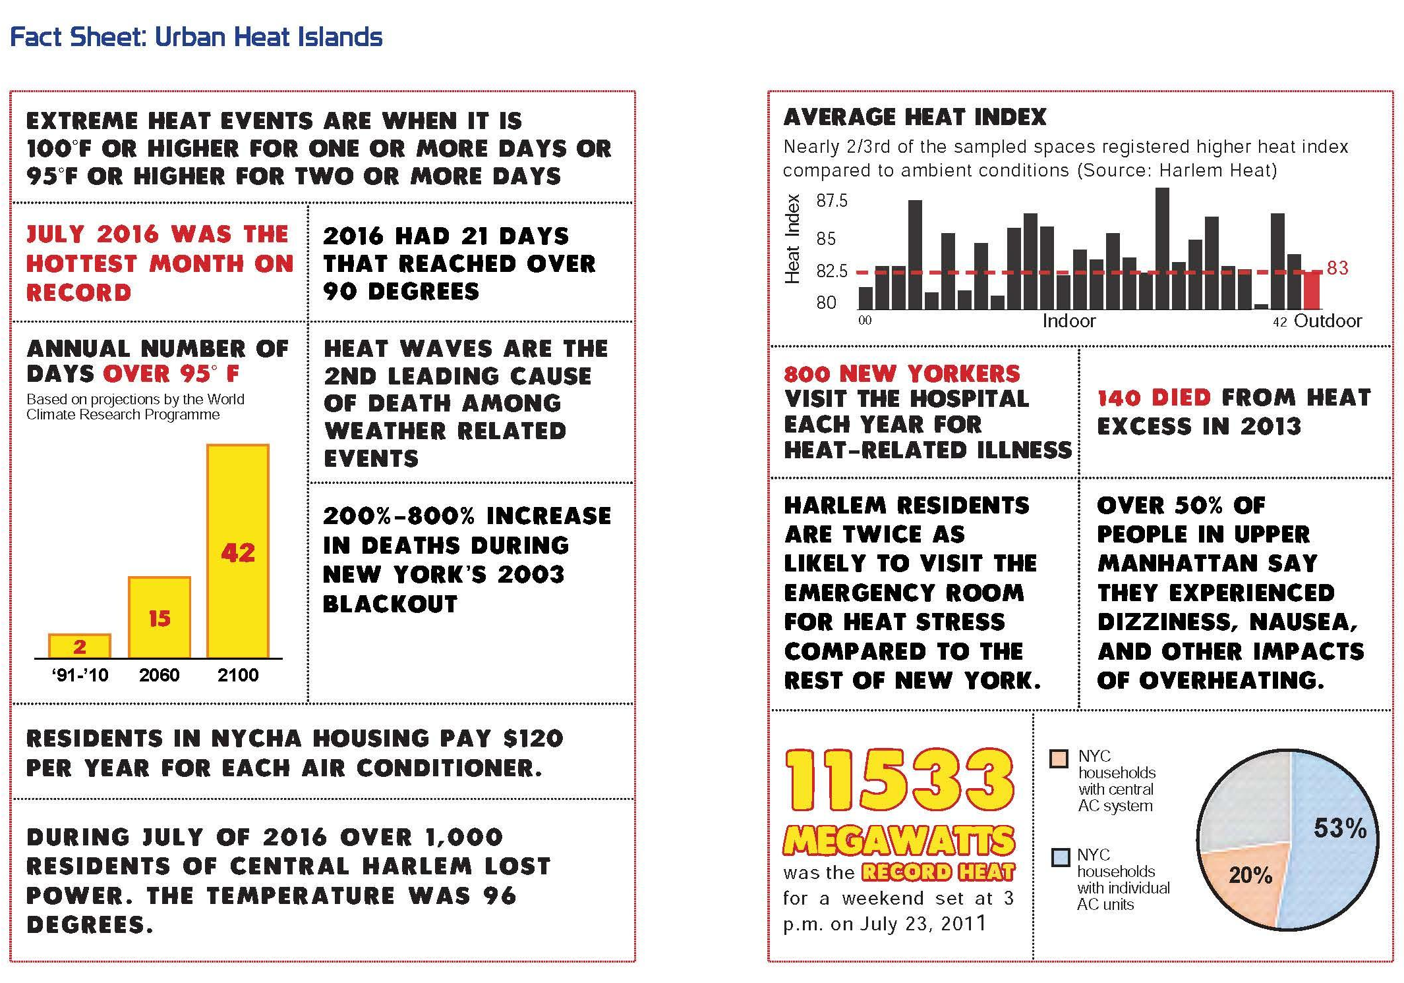
Urban Heat Island

Slide 13
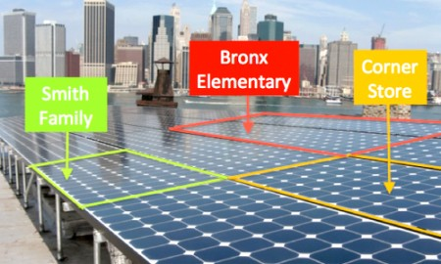
Community Shared Solar/Wind
Solar or wind whose electricity is shared by more than one household/business
'community-owned' or third party owned
Leveraging 80/50 investments
High barriers of entry
Housing security and access to bulidings
Partnerships with base-building organizations
Virtual net metering
Notes:
Simran

Slide 14
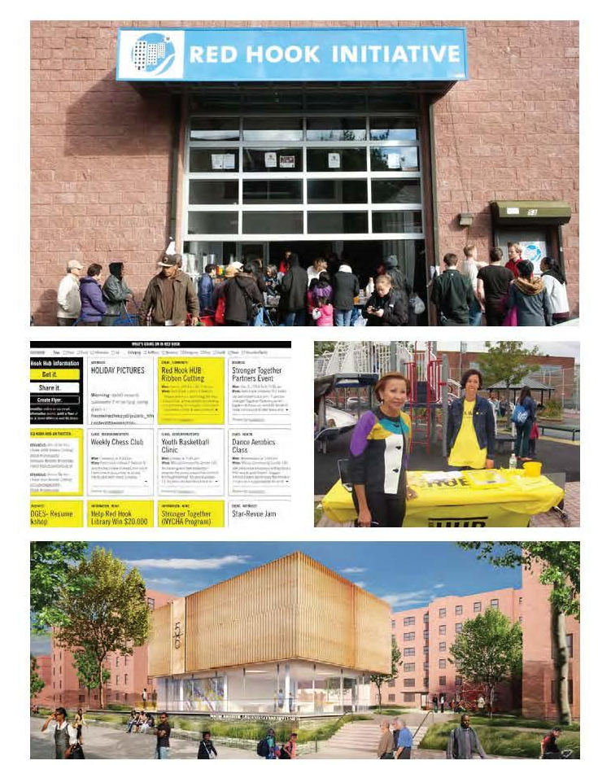
Net Zero Microgrids
Small network of distributed generation infrastructure
Extra layer of protection for ‘vulnerable’ areas
Provides energy for important community destinations
Supports shared solar/wind
Notes:
Simran

Slide 15
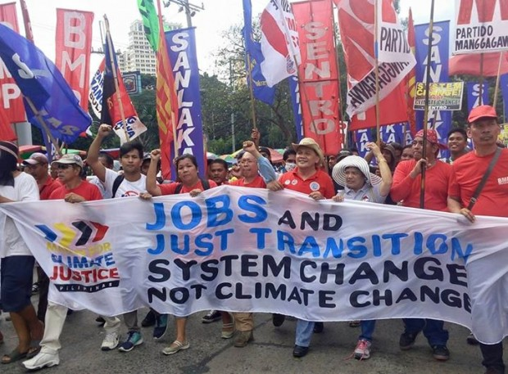
Just Transition
Connecting investments in renewable energy with environmental justice communities
Maximizing economic benefit by using ownership models, not just providing employment
Partnerships with organized labor
Partnerships with basebuilding organizations
Notes:
Simran

Slide 16
Finance and Access to Capital
Greenbank projects
State funding
investor to owner model
Cooperative investments (group purchasing)
Community Financial Development Institutions
Private donors
Capital projects
Community benefits agreements
Private real estate development
Notes:
Simran

Slide 17
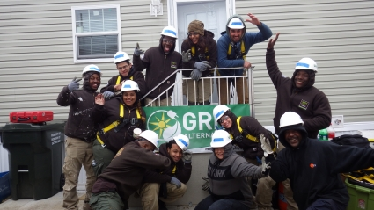
Community ownership models
Consumer cooperatives
Producer cooperatives
Group purchasing agreements
Community-based third party developers
Notes:
Simran

Slide 18
https://www.youtube.com/watch?v=A2c9vsJeGFM

