Slide 2
Resilience
"the capacity of an individual or of a social system to live well and to develop in a positive way, in spite of the difficult living conditions and, even more, the capacity to be strengthened and to be transformed by them”
(Helena Combarías)

Slide 3
PRESENT REALITY: UNDERSTANDING VULNERABILITY
Not only a matter of enhancing knowledge about the potential risks and impacts posed by the changing climate system
It is also a matter of engaging with historically complex and politically contentious factors that structure vulnerability.

Slide 4
Resiliency and Maintenance
Resiliency improves existing systems - change at the margins
Risk is acknowledged and that some of the symptoms of risk are addressed in a manner that maintains existing orders
The IPCC refers to resilience as a system which can absorb disturbance and retain structure whilst maintaining its ability to adapt to stress and change.

Slide 5
Transformational Resilience
Transitional – reforming governance (how problems are framed, solutions implemented, rights and responsibilities shared
Transformational – shifts the balance of political or economic power

Slide 6
CHRONIC Direct Impacts
CHRONIC
ACUTE
Impacts caused by changes in the environment, or existing social and economic vulnerabilities
ACUTE

Slide 7
Explore Hazards
Assess vulnerability and Risks
Investigate Options
Prioritize and Plan
Take Action
Implement
Role
Role
Role
Role
Role

Slide 8
Explore Hazards
Assess vulnerability and Risks
Investigate Options
Prioritize and Plan
Take Action
Implement
Identify a resiliency initiative or project in your city
What community capacities or resources are needed to ensure equitable outcomes at each stage?

Slide 9
Green Zones
Identifying overburdened communities
Increased resources for Green Zone communities
Cross-sector collaboration; planning
Targeting environmental enforcement
Reduce pollution; permitting;
Targeting land use planning
Community-based planning and asset building
Incentives for green economic development
Fair distribution of “green transition” resources
Energy Efficiency; renewable energy;
Equity at the CORE

Slide 10

Minneapolis
Climate Action Plan
Official City Environmental Working Group established in 2012, Plan final June 2013.
Buildings/Housing, Transportation/Land Use and Waste
Recommendations (on process and content):
Geographic acknowledgement
Co-health benefits
Targeting of smaller users of energy (renters, low-income)
Benefitting of green policies across demographics

Slide 11
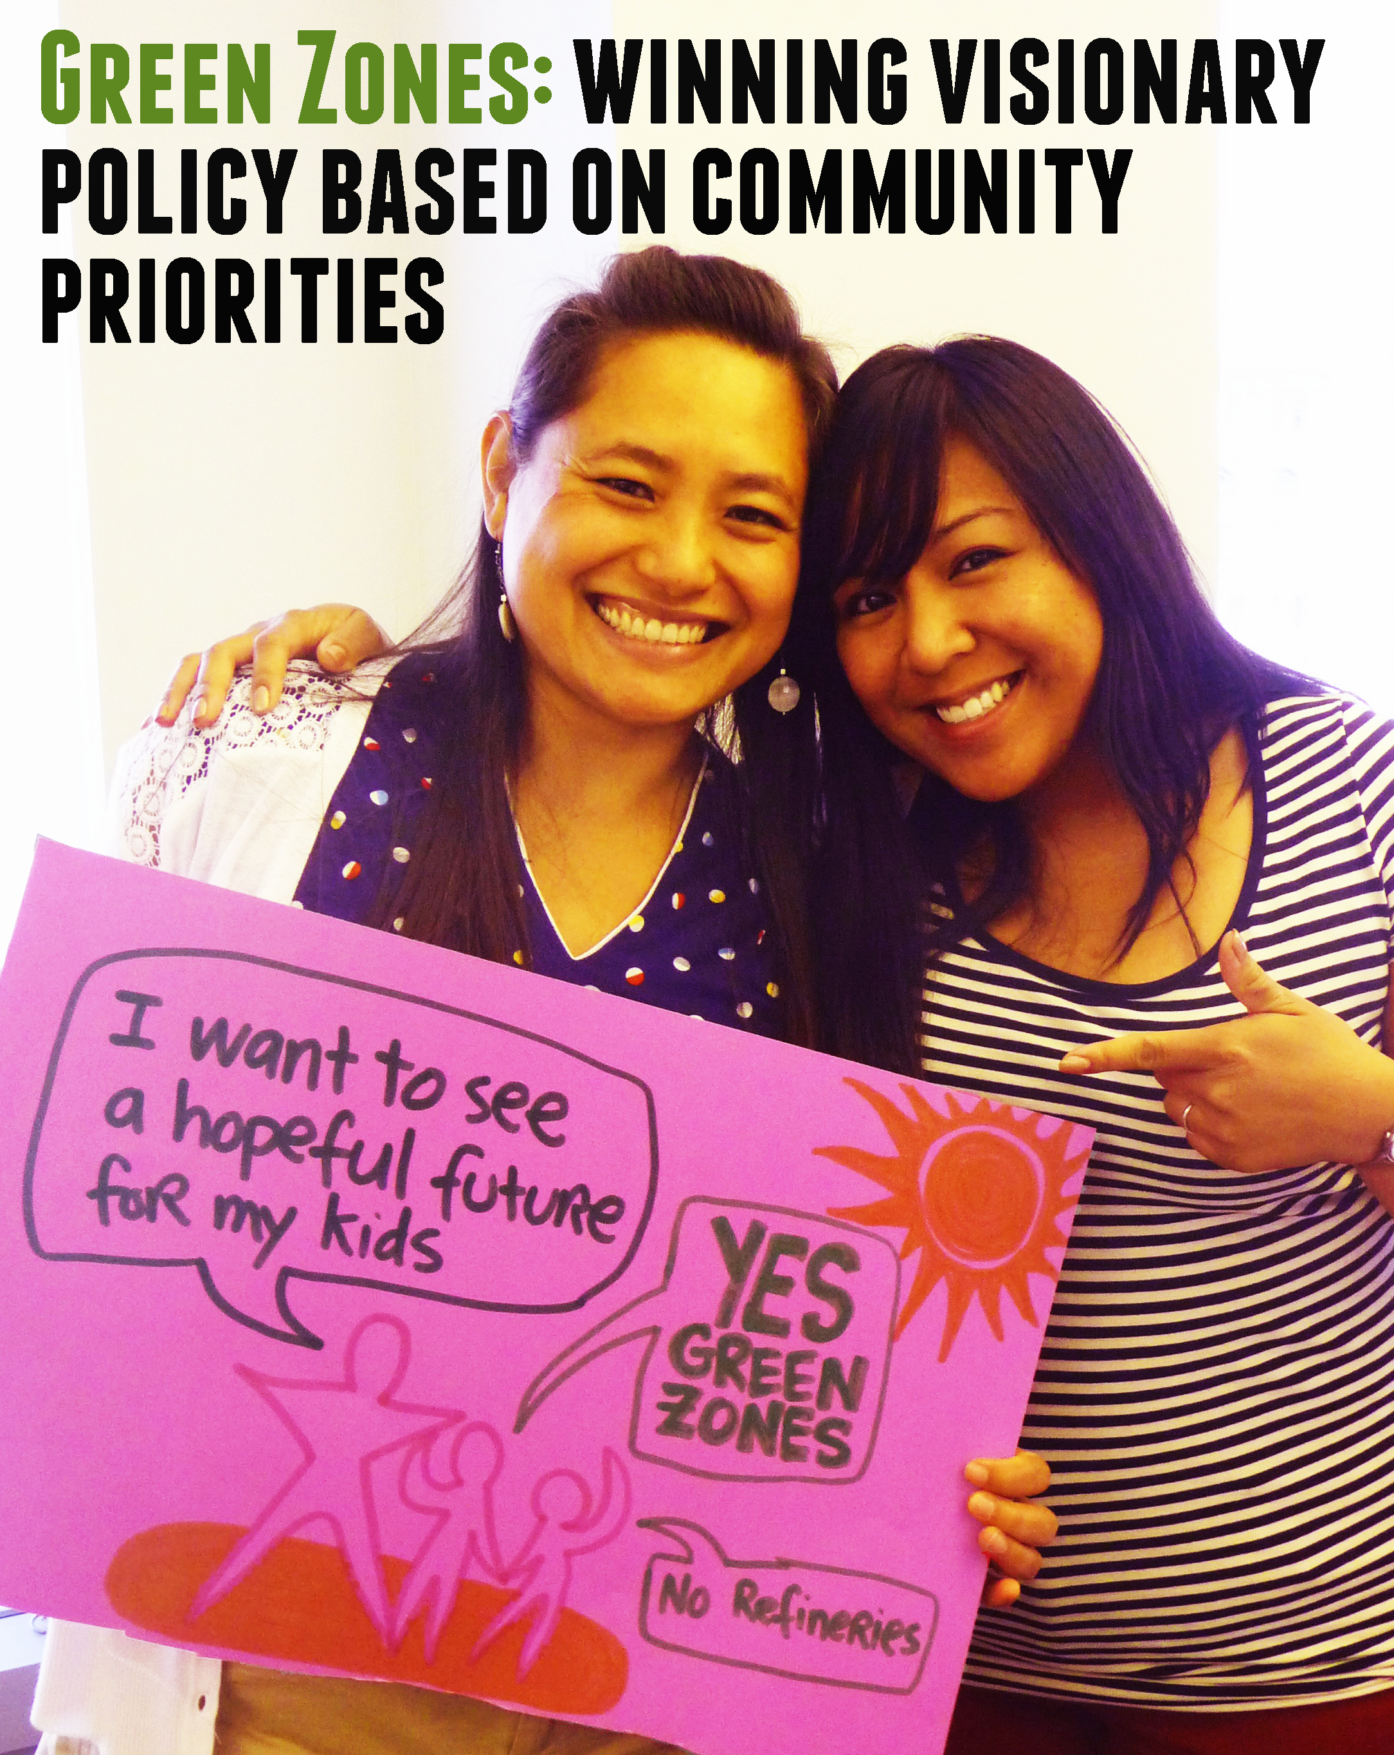
MCAP Cross Cutting Strategy #1: Green Zone Initiative
“The Green Zone Initiative will create a city designation for neighborhoods
or clusters of neighborhoods that face the cumulative impacts of environmental, social, political
and economic vulnerability.
A Green Zone is an environmental and economic development tool that targets new green infrastructure and retrofits to an area in a comprehensive manner.

Slide 12
Green Zones could correspond with targeted housing and commercial retrofit campaigns, to increase energy efficiency or boost renewable energy installation.
Areas with Green Zone designation may better be positioned to access benefits offered by the city as well as state and federal agencies, ranging from targeted pollution reduction to increased funding opportunities.”

Slide 13
Green Zones could correspond with targeted housing and commercial retrofit campaigns, to increase energy efficiency or boost renewable energy installation.
Areas with Green Zone designation may better be positioned to access benefits offered by the city as well as state and federal agencies, ranging from targeted pollution reduction to increased funding opportunities.”

