Slide 1


Communications Tools and Tips to Advance Racial Equity
Workshop with the Metropolitan Council
Dennis Chin & Gordon Goodwin
Race Forward/Center for Social Inclusion (CSI)
September 21st, 2017

Slide 3


Our Five Functions
Institutional and Sector
Change
Narrative Shift
Movement and Capacity
Building
Research
Policy Development

Slide 4
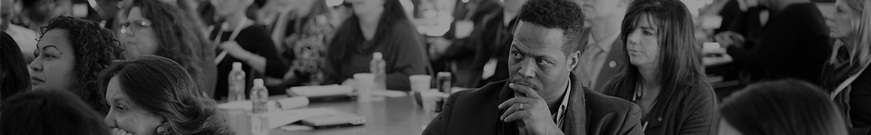
Government Alliance on Race and Equity
A national network of government working to achieve racial equity and advance opportunities for all.
Lead network – 50 members
Expand network – 30 states / 150+ cities
Provide tools to put theory into action

Slide 5
National effective practice
Normalize
A shared analysis and definitions
Urgency / prioritize
Organize
Internal infrastructure
Partnerships
Operationalize
Racial equity tools
Data to develop strategies and drive results
Visualize
Notes:
We think about communications as one tool in a process to operationalize racial equity in an institution.

Slide 6

This Morning’s Goals:
Learn/review key concepts on communicating about race effectively to different audiences.
Become more comfortable applying the ACT tool to common scenarios.

Slide 7
Creating a Learning Environment

Slide 8
Creating a learning environment:
Share the air
What is said here, stays here; what is learned here, leaves here
Offer what you can, ask for what you need
One mic, one diva

Slide 9
Reflection

Slide 10
Reflection:
What are your concerns/anxieties around communicating about race in your work?
What type of supports/resources would you need to feel more confident about communicating about race?

Slide 11
A Review

Slide 12
Racial inequity in the U.S.
From infant mortality to life expectancy, race predicts how well you will do…
Notes:
Policy-Driven
Structural racialization is driven by policies.
Multi-institutional (not just institutional racism)
Policy driven
Intent to discriminate not required
Impact is racialized
Impact on attitudes
Racial disparities are symptoms

Slide 13
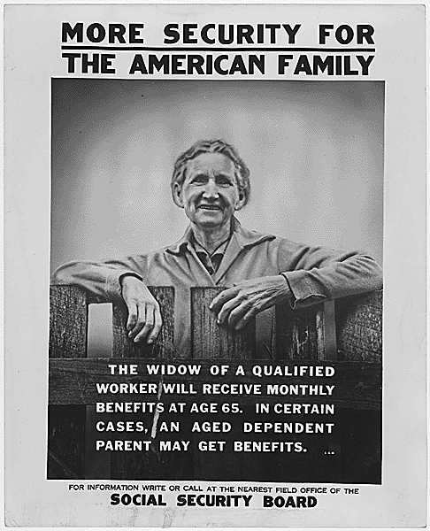

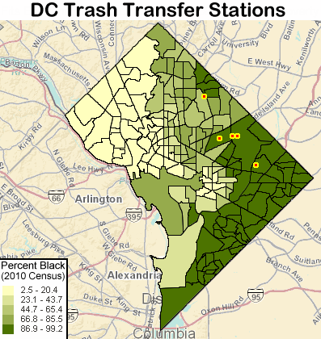
Policy created racial inequity:
New Deal
Federal Housing
Administration
Environmental Impacts
Notes:
Social security was first passed in 1935. At the time it was a novel idea. Notion that the government had a responsibility to take care of you in your old age- you had paid your debt to society. Well, the two professions excluded from coverage were farm laborers and domestic workers. Almost 2/3 of working African Americans, up to 80% in parts of the South, and over 1/2 of all working women were not covered. Was not explicitly racist, but it’s impact was as such. Perfect example of how whites are also harmed in policies with racist impact.
The Federal Housing Administration, for example, which significantly changed the way Americans bought homes and built communities largely left out people of color:
Favored suburbs over cities, cars over buses, and White neighborhoods over diverse ones
FHA manuals explicitly advised homeowners and brokers alike to avoid letting people of color into the neighborhood, labeling “pigpens and undesirable races as equally objectionable”
The program also encouraged homeowners to write racially-restrictive covenants, blocking people of color from many communities
Today, because black and brown communities have been under-capitalized, they were particularly vulnerable to predatory lending (50% of those with predatory loans could have qualified for prime loans and as you go up the income scale disparities between prime/subprime across race actually gets wider)
Race is the single best indicator for loan quality
The image on the right is actually a breakdown of Washington, D.C. showing where people are situated by race and the bright yellow dots with the red center are actually D.C. transfer sta9ons, which are very nice euphemism for garbage dumps. As you can see, all the garbage dumps are located in the highest popula9on communi9es with Black folks and there are literally none in communi9es that are 100 percent white.

Slide 14


Equity? Equality? What’s the difference?
Notes:
So everyone here has been to a major sporting event or to a show and half time or intermission comes and we all file out and head to the bathroom. The real question is, what is the difference in experience for men and women in using those facilities. And clearly wait lines can be anywhere from two to four to ten times longer for women than men in wait for a restroom. As we think about the difference between equity and equality, the question is how many restrooms are in those facilities for men versus women. They the same, they are equal. Half of us are men, half of us are women, so therefore half the restrooms are for men, half the restrooms are for women. But it turns out that for a whole slew of reasons in the ways in which restrooms are used and who designed the restrooms that the experienced outcome is quantitatively different. So equity is just recognizing that when a system is out of balance, that we need to apply a little bit of common sense and a little bit of justice to get to a different solution. So nationally, this conversation has led in many directions in the most pragmatic sense you have architects today saying, “I’m going to build two women's restrooms for every one men’s restroom.” But in a more transformational sense, you have folks in the transgender and non-gender conformity community actually just challenging our fundamental notions of gender. So we have gender-neutral bathrooms, we have family style bathrooms that are open to all and recognize that everyone needs access regardless of their gender. Part of the reason we are like this is just again naming, for example, the difference equality and equity but there is another element to this that really calls out what were trying to lean into equity.
*Another example would be curb cutouts for wheelchairs (this measure ends up benefiting everyone; people with strollers, shopping carts, suitcases, etc.) Elevators would be another example of a function that benefits multiple people.

Slide 15
Racial equity means:
“Closing the gaps” so that race does not predict one’s success, while also improving outcomes for all
To do so, have to:
Target strategies to focus improvements for those worse off
Move beyond “services” and focus on changing policies, institutions and structures

Slide 16

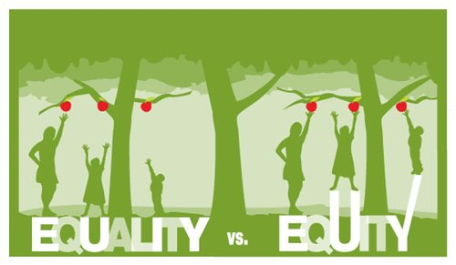
Equity statement:
Equity connects all residents to opportunity and creates viable housing, transportation, and recreation options for people of all races, ethnicities, incomes, and abilities so that all communities share the opportunities and challenges of growth and change. For our region to reach its full economic potential, all of our residents must be able to access opportunity. Our region is stronger when all people live in communities that provide them access to opportunities for success, prosperity, and quality of life.
Notes:
Why is equity good for society? Why is it important? What does it mean to be in a society? To be a resident in this country? What are our highest aspirations for the communities we want to create? Equity is not a zero-sum game, it’s about net benefiting everyone.
But what’s a big barrier preventing us from making the policy decisions that get us there? Narratives.
Doesn’t matter how strong our plan is; perception will trump our plans.

Slide 17
Dominant Narratives
Notes:
What are narratives? Stories that tell us why the world works the way it does.

Slide 18
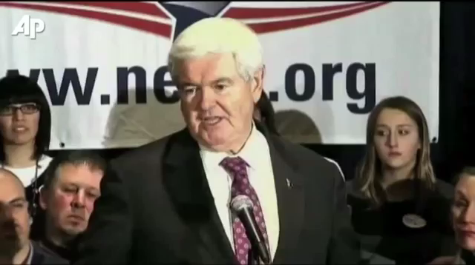
Dominant Narratives:
Notes:
What’s the narrative underlying what Newt Gingrich said? Handouts to Black people. This is what I would call a dominant narrative.
https://www.youtube.com/watch?v=VXcyX8blbu0
What’s the message? What’s the goal?
These narratives drive policies and practices that have created the racially disparate society we live in today.

Slide 19
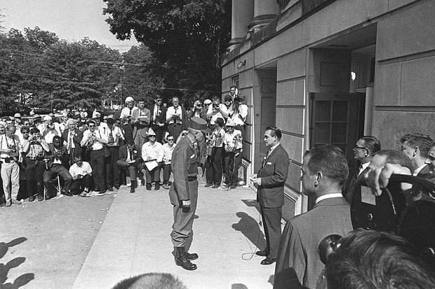
Dominant Narratives:
Notes:
Back to early 20th century, Southern Democrats created narratives that contained coded ways (words and images) to trigger racial fear and division in people's minds to win elected office, maintain segregation and thus, concentrate power in the hands of the few, the White.
WHO IS IN THIS PICTURE? George Wallace. He was one of the first to champion state’s rights. What do you think the narrative was in that instance? It’s the narrative of states’ rights – which tells the story about federal government interfering with individual liberty. But we all know what this was about – preventing racial integration.
You see, you didn’t have to say “Black people”. We call this the race wedge (others call it dog whistle racism). Over the years, politicians have perfected it in order to score political points. So even though they’re not saying race, they’re talking about it all the time. They trigger racial anxiety. This is the underpinning of the Southern Strategy.
What are some other examples of the race wedge? Good vs. bad neighborhoods. Welfare queen. Inner city. Food stamp president. Obamacare (makes you lazy “poor life choices”). Inner city. Reverse discrimination. Sharia Law. Illegal Aliens. Welfare Cheats. They’re taking our hard-earned tax money.
It’s not the words and images themselves, but who they couch those words and images (frames) in an overall narrative that sows fear, distrust, resentment and division.
DEFINITION - The term “race wedge” refers to the process of using race as a tactic to divide people in order to achieve a political outcome.

Slide 20
Why are dominant narratives so pervasive?

Slide 21

The Unconscious Mind
How our brains seek meaning:
Sort into categories
Create associations
Fill in the gaps
Notes:
Our minds are social. We are processing so much information at once. Our brain makes mental shortcuts.
These associations happen really fast and are shaped by the world around us (families, friends, media, elected officials, community leaders)
We are very divided. Our experiences are markedly different from one another.
21

Slide 22

Bias:
The evaluation of one group and its members relative to another.
We all carry bias. Acting on bias can be discriminatory and create negative outcomes for targeted groups.
Source: Unconscious (Implicit) Bias and Health Disparities: Where Do We Go from Here?
Notes:
Top 3 Takeaways:
Since we all carry schemas, we all carry bias.
Bias, in and of itself, it is not discriminatory. It might be preferential, but it’s not until we ACT on our bias that it becomes discriminatory. When that happens, bias can create negative outcomes for groups.
And, because of the way that dominant narratives permeate our culture and minds, we’ve all absorbed bias that favors or prefers White people over people of color.

Slide 23
Explicit bias
Expressed directly
Implicit bias
Expressed indirectly
Example – Sign in the window of an apartment building – “Whites only”
Aware of bias / operates consciously
Unaware of bias / operates sub-consciously
Example – a property manager doing more criminal background checks on Black people than White people.

Slide 24

What do to with bias?
Suppressing or denying biased thoughts can actually increase prejudice rather than eradicate it.
Re-prime
Reverse Opportunity
Stop and Think
Notes:
This can’t be exclusive to the work we do institutionally. WHAT ARE THE CHOICE POINTS?
Take time, break habits
Requires intentionality
Deeply examine our biases
Our brains are malleable
From Race Forward:
Re-priming – music selections
Reverse opportunity – hiring, evaluation, budgeting
Stop and think – allowing space and time to rethink

Slide 25
The Context
Notes:
Context: We’re all holding biases more than ever. But these biases are coming up.
Heightened racial anxiety
We are more segregated than we have been
Suburbanization of poverty – places where we spend non-competitive time together is less and less

Slide 26
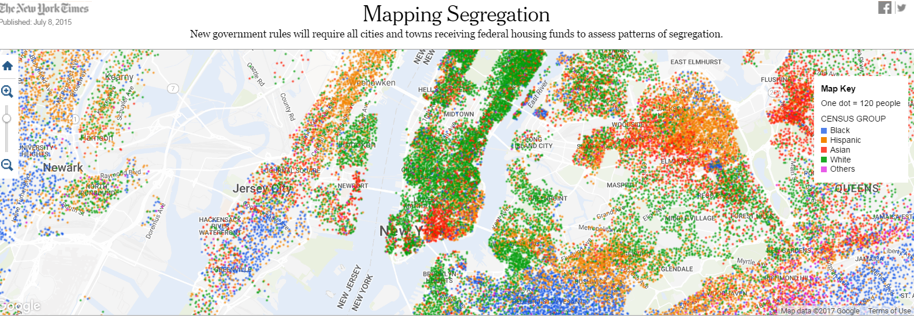
The Context:
Notes:
According to a study last year, 43% of Latinos and 38% of blacks go to schools where less than 10% of their peers are white - http://www.nytimes.com/2012/09/20/education/segregation-prominent-in-schools-study-finds.html?_r=0
American schools are more segregated now than they were in 1968.
https://thinkprogress.org/american-schools-are-more-segregated-now-than-they-were-in-1968-and-the-supreme-court-doesnt-care-cc7abbf6651c
http://www.cnn.com/2015/12/01/us/milwaukee-wisconsin-segregation-poll/index.html
https://www.nytimes.com/interactive/2015/07/08/us/census-race-map.html
SIMILARLY WE CAN’T ASSUME THAT ALL PEOPLE OF COLOR HOLD THE SAME VIEWS ABOUT WHAT IS HAPPENING IN THE COUNTRY

Slide 27
The Context:
Notes:
So why does this matter?
By 2042, our country will be majority non-white. Conversely, our aging population will be mostly white. By 2030, the majority of people between 20-34 will be people of color. This was the first year when the majority of new births are people of color.
Why does this matter? What will it mean for the solvency of programs like Social Security and Medicare if racial disparities maintain and deepen? How will it impact an older white population and how would impact communities of color if racial disparities maintain and deepen?

Slide 28
Frames

Slide 29


What is framing?
Framing is simply the way in which one chooses to present a story or issue.
Values
Notes:
THIS IS WHY OUR BRAINS ARE SO SUSCEPTIBLE TO DOMINANT NARRATIVE ON RACE. WE NEED TO KNOW HOW THESE BIASES ARE CREATING THROUGH NARRATIVE and therefore we need to know how we as a society developed these narratives.
Framing is the way in which we choose to present a story or issue. Think of the frames as a picture window. You choose what is in that window and can leave things out. We have frames in our head and they are the “unconscious thought process consisting of networks of associations that we use to interpret information. Frames are used as a long-term strategy in changing perceptions.” ~ CSI definition in report
They can include:
Values - Equality, opportunity, fairness (In this example, “resilience”)
Symbols – American flag
Metaphors – Sinking ship
Messages – “Hardworking American struggling in the economy” (In this example, “looting” vs. “finding”)
Messengers – Working class citizens, firefighter versus corporate CEO
Personal experience – Living in a community with lots of people of color vs not
People reject facts that don’t fit their frames or message until they do. For example, there are more White women on welfare than Black women but people will fight off this fact because it doesn’t fit their frame of who is on welfare.
People can carry multiple frames that are sometimes linked and sometimes contradictory. They surface by getting activated. For example, there can be social security recipients against “government handouts.”
Framing is a long-term project because people need to receive it in multiple foovertime to actually shift it
Frame: For example, how a single word evokes a host of associations (e.g. restaurant makes you think of food) Tax Relief or Burden

Slide 30
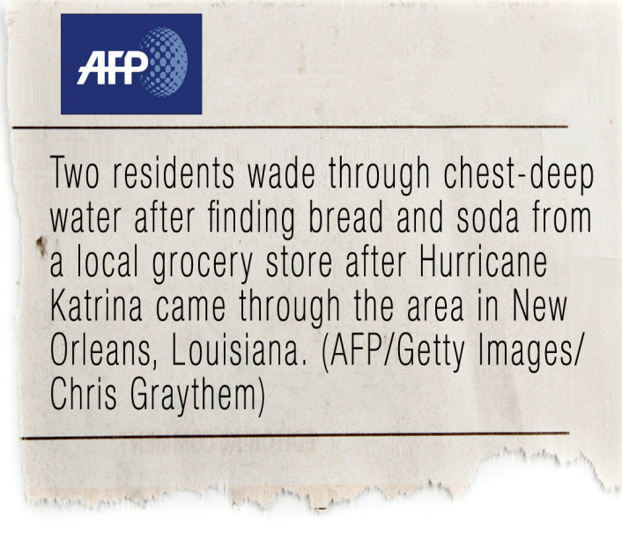
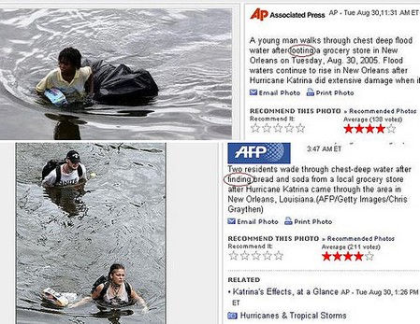
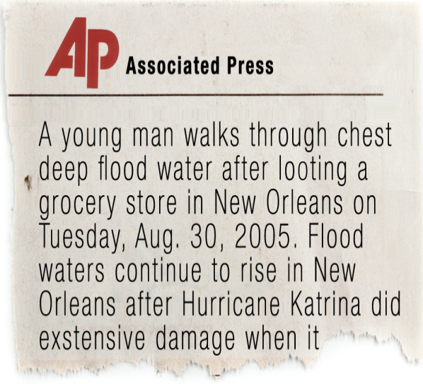
Notes:
How many people did this go through? So it runs through institutions.

Slide 31
How framing creates the race wedge:
Explicit and Implicit Biases
Race Wedge
Racial frames
Using symbols/ words to trigger unconscious racism
Notes:
Core of Southern Strategy.
We are in a post-factual world. In fact, people tend to embrace data that support their life views and reject data that refute them. Actually may get folks to clamp down on their view. What are the values of the people that you’re trying to convince and how do you connect to those values in a way that gets you to mobilize towards a common cause?

Slide 32
Dominant narratives that result:
By Eduardo Bonilla Silva
Racism and racial inequality are things of the past “White people are doing worse than people of color”
Disparities caused by culture/behavior “Poor youth of color don’t do well in school because their families don’t value education”
Disparities inevitable and/or natural “Some group has to be at the bottom” or "Self-Segregation"
Programs helping people of color are unfair to White people a.k.a. reverse discrimination
Notes:
Foreigners are destroying our way of life
Islam is a threat to America

Slide 33
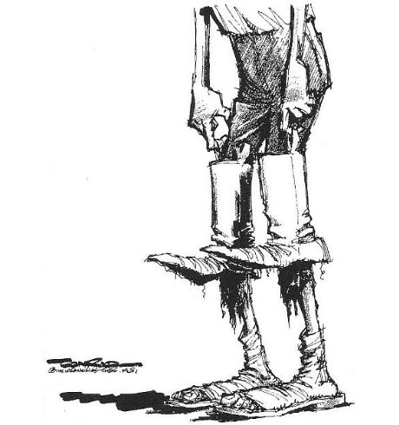
Meta-Narratives:
Using symbols/ words to trigger unconscious racism
Notes:
Pull yourself up by your bootstraps

Slide 34
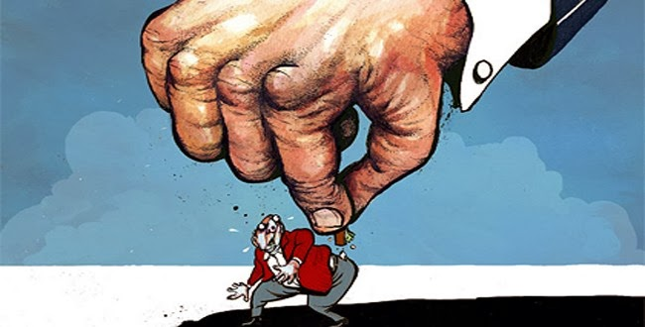
Meta-Narratives:
Using symbols/ words to trigger unconscious racism
Notes:
Government

Slide 35
Review:
Why do people think the way they do about race?
Our brain is wired to make shortcuts. We are socialized to make shortcuts about people of color.
What is framing?
How people present a story or issue. People will reject facts that don’t fit their frame
What is the race wedge?
The process of using race as a tactic to divide people in order to achieve a political outcome.
What are dominant narratives?
The stories we are socialized to believe about how the world works

Slide 36

Basically, what does this mean?
People will fall back on their biases because of dominant narratives
Facts are not enough to challenge people’s biases
We need to re-frame t0 create new narratives

Slide 37
What are the dominant narratives?
What other dominant narratives on race are playing out in the region, state, and nation?
How, if at all, has your department/institution responded t0 these narratives? What’s worked? What hasn’t worked so well?
How have you seen dominant narratives on race play out in your personal/professional life?

Slide 38
How do organizations/institutions effectively communicate about race to challenge dominant narratives on race and advance racial equity?
Notes:
Developing and sharing tools to talk about race and shift the dominant narrative.
Since 2011, CSI has worked with social scientists to figure out the best strategies to talk about race in order to move a broad base of people to support racially equitable policy solutions. We train grassroots leaders, community-based organizations, advocacy and philanthropic organizations, and government to talk about race effectively in order to move a policy agenda that can create shared prosperity in our neighborhoods, states, and nation. Our aim is to unite community organizing and advocacy with cutting-edge social science research to create effective communications strategies for those working to make racial equity a reality.

Slide 39
Guiding Principles
Notes:
It takes time. It takes multiple approaches. Our approach is derived from research and a community of knowledge from organizers and activists.
Be explicit, not exclusive
Impact, not intention
Tie to strategy, not morality
NO silver bullet

Slide 40
Know your audience
Source: SPIN Academy
www.spinacademy.org
Evaluation
Tools
Message(s)
Audience
Infrastructure
Notes:
Who’s your audience? What do they value? What are their day-to-day concerns? Organize focus groups. Feedback from organizers. How you test your messages.

Slide 41



Set an effective tone/context

Slide 42
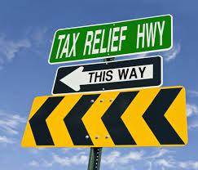
Choose your metaphors wisely
Source:
George Lakoff
Notes:
'Taxes are what you pay to be an American, to live in a civilized society that is democratic and offers opportunity, and where there's an infrastructure that has been paid for by previous taxpayers.’ George Lakoff
Food deserts

Slide 43
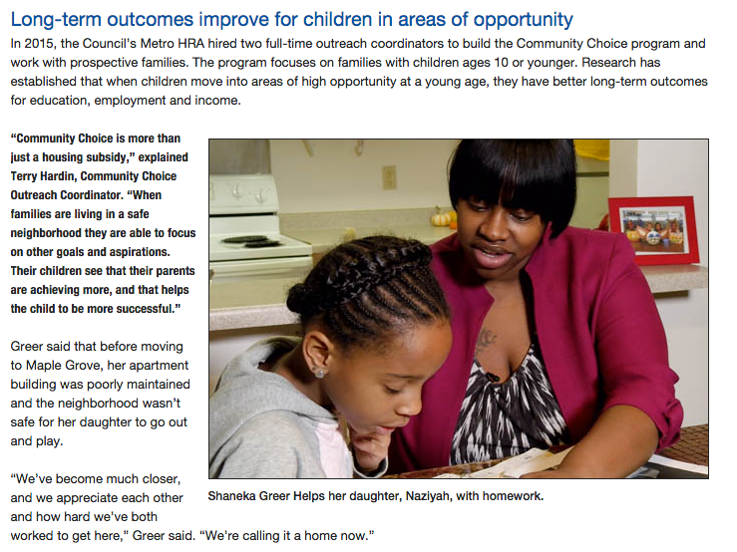
Constituents as storytellers:
Notes:
Your Story – What was your AHA moment in the workshop materials? How has your family or loved ones been impacted by structural racism? Were your parents able to get a housing loan or were they denied? In what ways did you family or loved ones benefit or not benefit from policies, practices, procedures that make up our society?
Story of Self – Why you were called to what you have been called to do
Story of us – What your constituency, community, organization has been called to its shared purposes, goals, vision. (Who is “we?”)
Story of now – The challenge this community now faces, the choices it must make, and the hope to which “we” can aspire.
WE ARE WIRED FOR STORIES

Slide 44
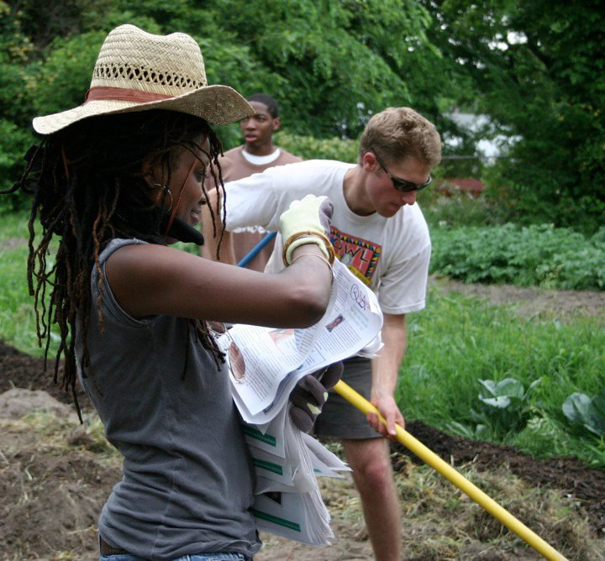
Frame people of color as assets:
Notes:
Not savior mentality. Don’t want to frame POC as solely victims.
Food deserts –food apartheid

Slide 45
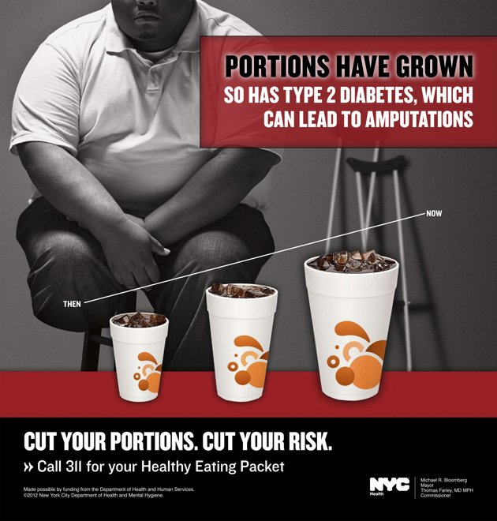
Tell the structural story:

Slide 46
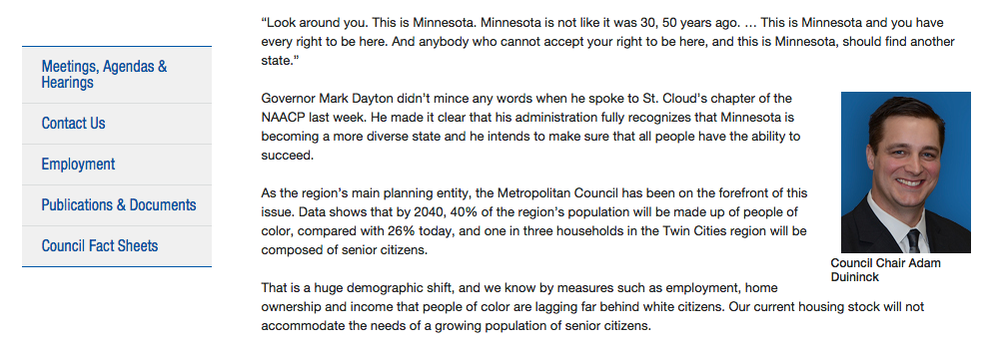
Tell the structural story:

Slide 47
The Tool
Notes:
Borne out of social science research in 2011.
Dial testing
Better to name race than not or else people will fill in the blanks

Slide 48
Communicating about race External
Affirm
Counter
Explain structural roots and realities
Transform
Reframe winners and losers
End with heart and a solution
Start with the heart
Explain why we are all in this together
Take on race directly
Notes:
Like elements of these can be woven into a conversation.
Based on message testing research
Based on community of practice among community organizers who have been doing this work for decades.

Slide 49
Communicating about race External
In Colorado, many of us take pride in our ability to enjoy a healthy and active lifestyle. Ensuring that all kids have the opportunity to enjoy Colorado’s clear air and open spaces starts in the earliest years of a child’s life. While it’s critical that all Colorado children have health insurance that lets them seek care when they need it, it’s important to remember that healthy lives happen outside of the doctor’s office. It’s our responsibility to make sure kids of all races and ethnicities have access to fresh foods, safe places to grow and play, and resources to get the care they need.
Affirm
Start with the heart
Explain why we are all in this together
Notes:
AFFIRM
Start with the heart
Start message with emotional connector to engage audience in the message. For example: We work hard to support our families, and all our contributions help make America great.
Explain that “we are all in this together” across race
Explain “shared fate” in racially-explicit terms. For example: It hurts the same to lose a home or job, whether we are White or Black, male or female, a single parent or a two-parent family.

Slide 50


“Affirm” Tips:
Speak in human terms
Lead with shared values, not problems
Describe the vision for our communities and how your audience fits into that vision.
Use stories that are evocative and specific
Artists: (L to R)
Micah Bazant
www.micahbazant.com
Just Seeds
www.justseeds.org

Slide 51
Communicating about race External
Unfortunately, research shows that the circumstances of a child’s birth often have lifelong impacts on their health. Our shared legacy of unequal opportunity drives continuing inequities in access to health care and the building blocks of a healthy lifestyle. Historical discrimination makes children of color more likely to be born into families where financial hardship creates barriers to accessing health care in the earliest years. Policies and practices continue to isolate children of color in high-poverty neighborhoods where nutritious foods and healthy infrastructure are hard to come by.
Counter
Explain structural roots and realities
Take on race directly
Notes:
COUNTER
Explain why we have the problem
Tell us how we got here in simple terms
Give a very brief explanation of what has happened in the past and explain why we have a problem today.
For example: In the past, to create more jobs and to make our economy work, as a country we invested in schools and universities; we invested in buses, subways, and highway repair. Now, our leaders say we have to slash investments in our future and far too many hard working Americans who make real contributions to our society are losing their jobs and homes
Take on race directly
Take on race wedge by declaring it and dismissing it
For example: This is not about immigration or welfare. This is about whether Americans will see their children off to college, see their parents get the health care they need, or whether people can feed their families three healthy meals a day.

Slide 52
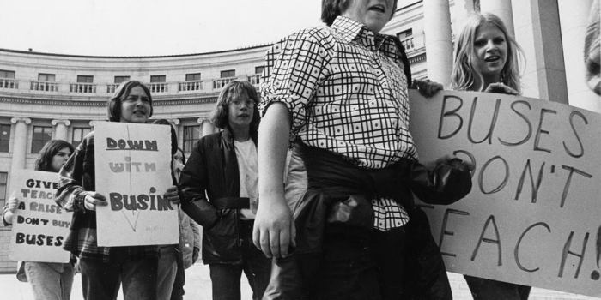
“Counter” Tips:
Be explicit about race
Be clear about the structural story (Here’s a trick: Check that you are using active voice)
Avoid or dismiss the “race wedge”
Notes:
People often just name the disparity. Because of dominating narratives we fill in the blanks.
ID the race wedge – counter it. Be explicit about it if you can.

Slide 53
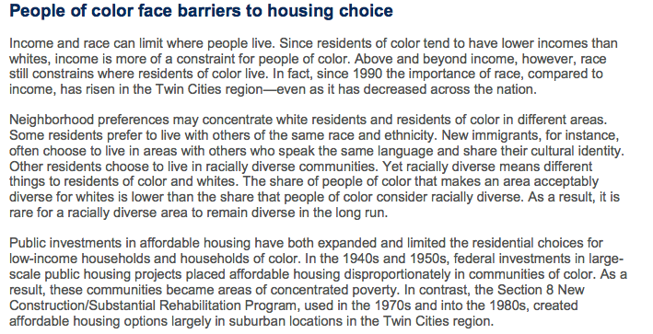

Slide 54
Communicating about race External
Colorado has long enjoyed a reputation as one of the healthiest states in the nation. But healthy living shouldn’t be limited to our world-class skiing, mountain air, and miles of trails—it must also include safe sidewalks, nutritious school lunches and health coverage for all. The vibrant future we envision for our state depends on the well-being of our children. Let’s make sure that each child, no matter the circumstances of their birth, has the opportunity for a healthy life.
Transform
Reframe winners and losers
End with heart and a solution
Notes:
TRANSFORM
Reframe “makers” and “takers”
Change and define who actually contributes and who actually takes advantage of large-scale systems.
For example: Medicare, social security, and college loans are all opportunities WE ALL helped create. Corporations and the nation’s wealthy, like CEOs, need to do their part like hard working Americans so that we can keep this country investing in our future.
Another example: In the information economy, the dollar value of Facebook or WhatsApp is created by the users – not by the employees.
End with the heart and a solution
Present a solution in emotional terms, and ask people to join you.
For example: It’s time those who have benefitted most from the opportunities we all created, corporations and the wealthy, help pay for schools, health care, transit and more—and that we don’t continue to give them a free pass.

Slide 55
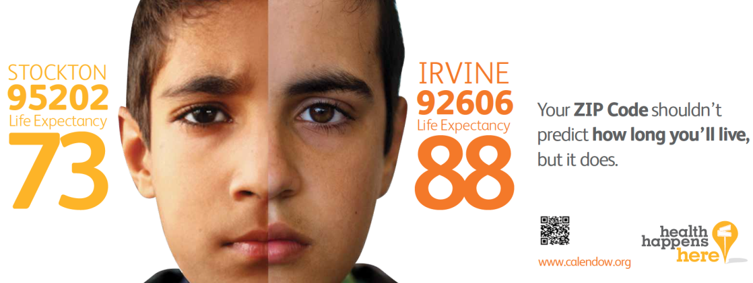
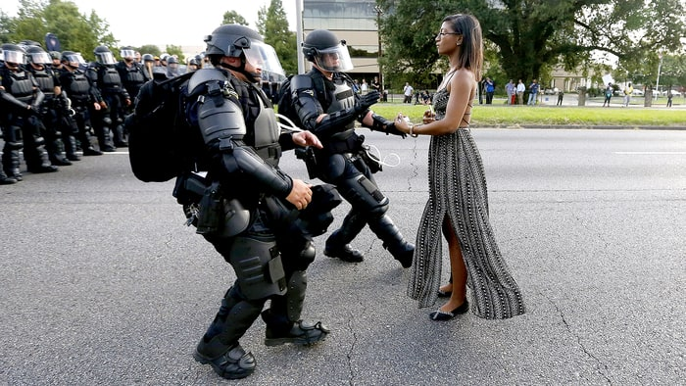
“Transform” Tips:
Allude back to the heart.
Identify root causes of the problem
Invite audience to make a choice or take action.
Ad Source:
The California Endowment
Notes:
POC are not just victims. IN some ways, we are survivors. Keys to survival are often located within COC. Colette story
Who is really at fault
What solutions could we offer? (IE. WE’RE DOOMED PLEASE JOIN US)
CHOICE POINTS – contrast the world we’re in vs the world we want to be. What’s the choice? What’s the contrast?

Slide 56
It’s more than just talk – ACT
Affirm
What will it take for our children to achieve their dreams?
A high quality, public education unlocks the potential of all of our children to learn about themselves and the world—using math, words, arts, sports, and more.
Counter
Currently, only about 50% of Black, Latino, and Native American students graduate from high school by the age of 18. There are many reasons for this. One is that harsh, punitive school discipline based on subjective infractions drive students of color into the criminal justice system.
This is called the school-to-prison pipeline. Instead of investing more resources to help students succeed, this system drives students out of schools and into prisons.
Transform
Schools should instill hope and curiosity about the world. Alternative methods of discipline, such as meditation, art, and mediation, have proven to be far more effective in supporting and encouraging all of our students to succeed.
Our schools can be havens where all our children can unlock their full potential. Join us to make this a reality for our kids and families, in every town and city across the state.

Slide 57
Communicating about race Internally
Affirm
Counter
Counter resistance
Transform
Transform inertia to action
Affirm your colleagues
Think about the info your colleagues need to move forward
Think about the resources available and next steps for your colleagues
Think about how your colleagues will react to the plan or process
Notes:
Speaking with colleagues/partners/funders.
Basic communications skills – Listening to understand, rather than thinking about what you’re going to say next.

Slide 58
Scenarios

Slide 59
Share your messages

Slide 60
The time is always right to do what is right.
Faith is taking the first step even when you don't see the whole staircase.
― Martin Luther King, Jr.

Slide 61
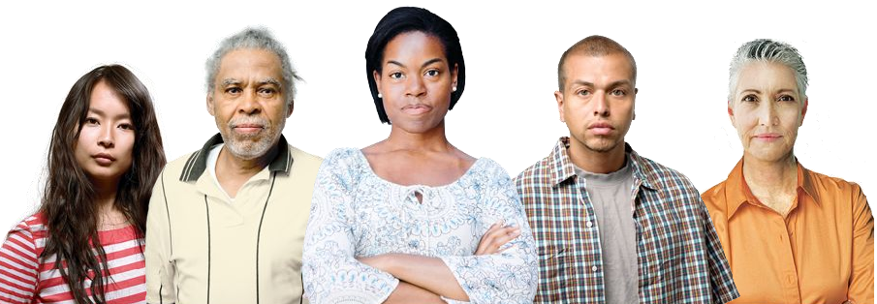
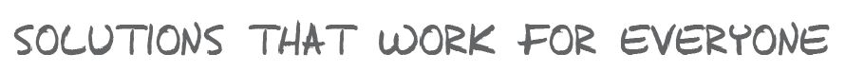
Stay Connected:
centerforsocialinclusion.org
Raceforward.org
Racialequityalliance.org
Contact us:
Dennis Chin – dchin@thecsi.org
Gordon Goodwin – ggoodwin@thecsi.org

