Slide 1


Community Engagement: Critical Conversations for Authentic Connections
August 18, 2017
Notes:
CLAUDIA

Slide 2
Brief Overview of Today
Introductory Presentation
Global Café Sessions
Break
Small Group Case Studies & Report-Out
Close-Out Activity
Notes:
CLAUDIA

Slide 3
Engagement Specialists With Us Today
Jack Becker, AICP
Community Services Director, Forecast Public Art
Caty Royce
Executive Director, Frogtown Neighborhood Association
Kate Khaled
Managing Director, Imagine/Deliver
Avi Viswanathan
Program Director, NEXUS Community Engagement Institute (CEI)
Notes:
CLAUDIA

Slide 4

Ahh! Community Engagement!
“I have to speak to the public; I am not trained in this!” “People don’t like what we do.” “I have enough on my plate.”
Notes:
CORRIN- COMMUNITY ENGAGEMENT?! “WHAT WE HEAR FROM PEOPLE”

Slide 5
What is Authentic Community Engagement?
Public Outreach & Community Engagement:
Not the same thing.
Public Outreach: focus is on a specific project for a defined timeframe to solicit input.
Community Engagement: focus is the long-term; build relationships with “intended beneficiaries” and community organizations to form a strong network.
It is not a single event, but an ongoing process.
Notes:
CLAUDIA- Community expertise is respected. Policy is talked about in a way that is accessible to community, e.g., plain language. Authentic community engagement starts with creating relationships, sharing leadership, and then evaluating results, e.g., Did the community members feel welcome and heard?

Slide 6

Tips and Hacks for Getting Good at This
Fake it until you become it; leave your comfort zone
The benefits include personal growth
Notes:
Corrin: Public speaking. Warren Buffett pointed out that “mastering the art of public speaking is the single greatest skill to boost your career.” In fact, he said that this one skill will boost your career value by 50%! (www.inc.com)
You might be thinking, "That's great, but I have a fear of public speaking." That's OK. Buffett was actually terrified too.
Stand tall, shoulders back, and do it. Channel someone else if you need to, a favorite athlete or whoever. Right now, I am channeling Wonder Woman.

Slide 7
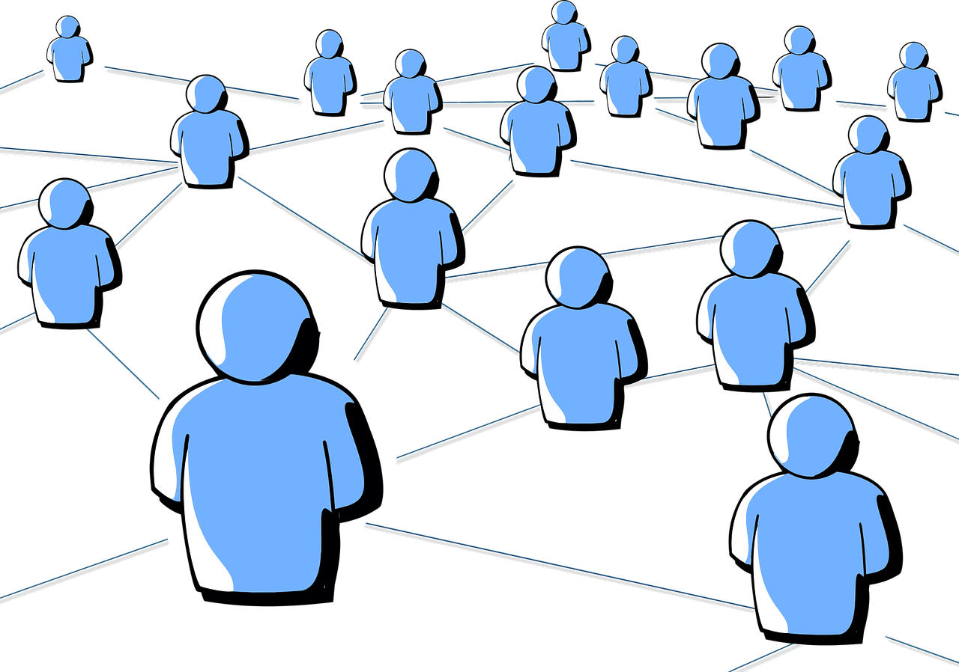
Make connections with people before you need them.
Notes:
CLAUDIA: MAKE CONNECTIONS with people before you need them
It takes leaving your bubble to try new things and meet new people.
Find your allies within your organization and out in the community. This is how partnerships are made.
Opportunities to meet potential community partners/allies can occur randomly, e.g., LinkedIn.
Example: Suado project

Slide 8
Trust is Earned!
CONTACTS:
Not going to automatically yield results
You have to establish rapport
LISTEN:
“Set aside your knowledge and come to the table ready to learn” (StreetsMN)
Notes:
CLAUDIA: Example: Establishing common ground with a community member may include chatting about family or seemingly non-work related topics but it is relevant to what we are trying to build. I watch how planners network, e.g., “I went to Rutgers, where did you go?” Although community members may have a different background, you can still find common ground. (Katie and Latinas example)

Slide 9

Engage People Early in The Process
Connect early on
Let people know how you are using their input
How do they want to be kept updated?
Let people know why an idea was not achievable
Notes:
CORRIN: FOLLOW THROUGH BY ASKING PEOPLE HOW THEY WANT TO LEARN ABOUT THE OUTCOME OF THE PROJECT/POLICY.
If the community was really supportive of an idea that did not make it into the project, let people know why. Perhaps it was a great idea that was not achievable due to a budget constraint or a state policy (Streetsmn)

Slide 10
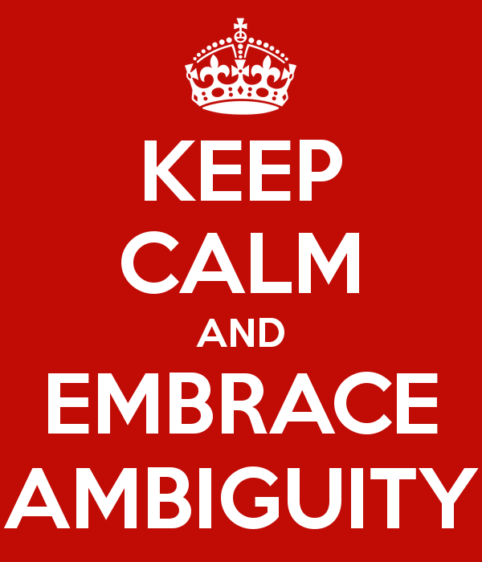
Are you comfortable not knowing or do you demand certainty?
Notes:
CORRIN: Now, think a moment when you were a kid and your world was full of unlimited possibilities.
It was thanks to your capability to embrace ambiguity: a packing carton case, for example, could be much more than a simple packing carton case: it could be a car, a house, a fort. Then something happened, maybe someone said: "Curiosity killed the cat" ... and so you missed the excitement of exploring different ways to see things and you suddenly understood that it was just a simple packing carton case.
It is therefore essential that you embrace again ambiguity and feel comfortable in uncertainty because this is where it is possible to explore new ways of seeing things; and new ideas, solutions and possibilities can emerge. (Alessia Correa)

Slide 11
The best way through the fog is through the fog!
Engaging community is about letting multiple viewpoints swirl around simultaneously. You don’t know how it’s going to work out, and the unknown is fearful!
“Give yourself permission to explore lots of different possibilities so that the answers can reveal themselves” (www.ideo.org)
Notes:
CORRIN

Slide 12

Expect Obstacles and Resistance
It is hard work to grapple with new possibilities. It may even threaten people’s identities or interests (or perceived interests) to do so.
It takes time and repeated opportunities for people to really work through problems, absorb information about the trade-offs of different approaches, and build common ground. (www.publicagenda.com)
Notes:
CLAUDIA- Example: US Bank Stadium project, LRT. Compromise is about having “Something for everyone to hate.” Goal: People showing up and leaving with an attitude of, “Don’t like the project but staff is polite and they know their stuff.

Slide 13
Control Your Controllable Variables
Location, Location, Location
Where are the people you are trying to reach? That’s where you need to be.
Lots of people have kids- they have feedback too. In fact, teens seem to know everything.
Use tactics…
Notes:
CORRIN: Probably the best meetings I attended were in locations were the intended audience was already at. Planning for a park? Hold the meeting at the park. What about farmer’s markets, grocery stores, the laundromat, or community festivals? Where are the people you are trying to reach? That’s where you need to be.” (StreetsMN)
Lots of people have kids— they have feedback too. In fact, teens seem to know everything. Use tactics like Pop Up Meeting, created by Public Art Saint Paul City Artist Amanda Lovelee, is a fun tool with the goal of increasing diversity and participation in planning processes.

Slide 14

Make it Part of Your Workplan
Is building relationships/expanding networks part of your workplan? Is it prioritized?
It should be a formalized part of your job.
Notes:
CORRIN

Slide 15
Thank You!
Corrin Wendell, AICP
Senior Planner & Sector Representative, Community Development
Corrin.Wendell@metc.state.mn.us
Claudia Fuentes
Outreach & Engagement Coordinator, Communications
Claudia.Fuentes@metc.state.mn.us
Notes:
CORRIN

Slide 16
Case Studies- Pick One!
#1
Mississippi Mobile Home Community
#2
Post-Disaster
Roundtable
#3
Underserved and Underrepresented Communities
#4
No Community-Based Networks

Slide 17
Upcoming PlanIt Events
Building a 21st Century Suburbs Workshop Thursday, August 24, 2017, 9 AM-11 AM
Water Management Tools: Going Beyond the Comprehensive Plan Workshop Tuesday, September 12, 2017, 8:30 AM-12:30 PM
For registration and more information, please visit the PlanIt website!

