Slide 1

Onboard Passenger Information System
February 2026
Nathan Bakken | Sr. Data Coordinator, Customer Experience
Melissa Bisila | Product Manager, Customer Experience

Slide 2
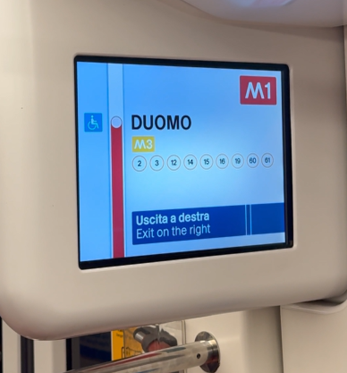
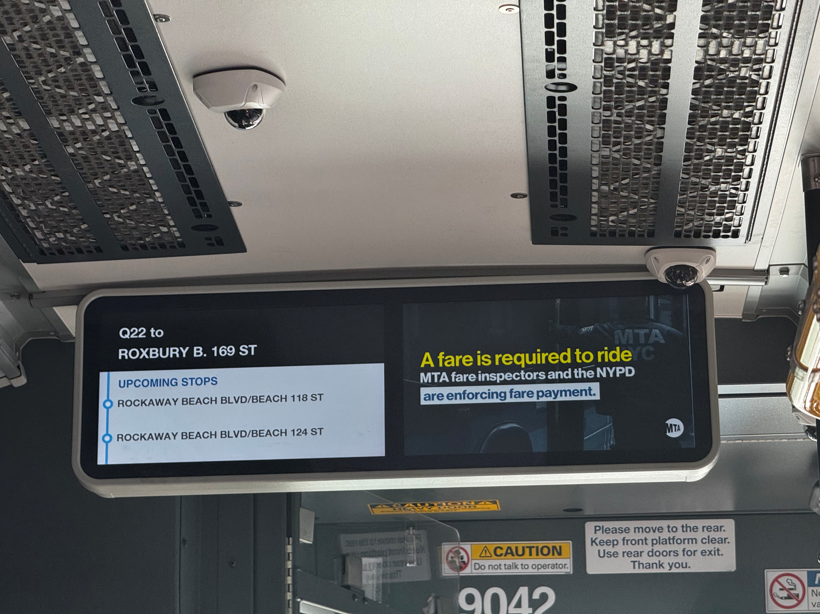
Overview: Onboard PIS
Why?
  Better information.
  Improve customer experience.
Other transit agencies have implemented onboard signs that provide useful wayfinding information.
Notes:
TIS engaging vendor

Slide 3
Project Approach
Prioritize rider information needs.
Identify operational and maintenance needs.
Pilot 2-3 technologies onboard Bus Rapid Transit and Light Rail.
Use pilot to inform broader rollout.
Notes:
Guidelines - Topic Guide on Stop Announcements and Route Identification
Proactive response – Logging, Monitoring Alerting and Reporting
Reduce manual labor – Leverage existing data connections (RTS APIS) and text to speech technology
Reduce system complexity – Leverage existing network connections instead of iNet

Slide 4
Project Timeline
Winter 2025-2026: Define requirements and vendor research
Spring-Summer 2026: Issue Request for Proposal for Pilot
Winter 2026-2027: Select vendor(s)
2027: Pilot

Slide 5
Current Status of Project
Rider research completed
  Findings:
    Next stop information is highest priority
    Knowing where the vehicle is enroute to its destination is next important
    Arrival times, detours and transfers are high on the list of priorities
Operational research in progress
  Working with stakeholders across bus and rail to identify vehicle capabilities
  Identify vendors that are compatible with our vehicles
  Finalize scope and budget
Notes:
Make sure to describe our method of engagement for rider research.
Survey on Transit App
Survey conducted onboard buses and LRT routes to ask riders about their information needs
179 responses good variety of ages and demographics included
We did not specifically target disability community but their feedback would be included as route coverage was fairly comprehensive

Slide 6
TAAC Engagement
Be aware of this effort.
Provide feedback during pilot.

Slide 7
Thank You!
Nathan Bakken
Nathan.Bakken@metrotransit.org
(612) 349-7414
Notes:
Make sure and share with Ben once we are done with this.

