Slide 1

Stop-Level Signage Evaluation TAAC Update
4 February 2026
Jasna Hadzic-Stanek | Customer Experience Sr. Project Administrator
Tariq Muwahid | Customer Experience Field Operations Specialist
Notes:
Mission: To support riders with accurate, customer-friendly information
Vision: Every Rider has timely, accurate information so they can ride with confidence & ease
Purpose of Presentation
• Share findings from rider engagement on stop signage
• Summarize what customers want at Tier 2 stops
• Present recommendations for improving stop information

Slide 2
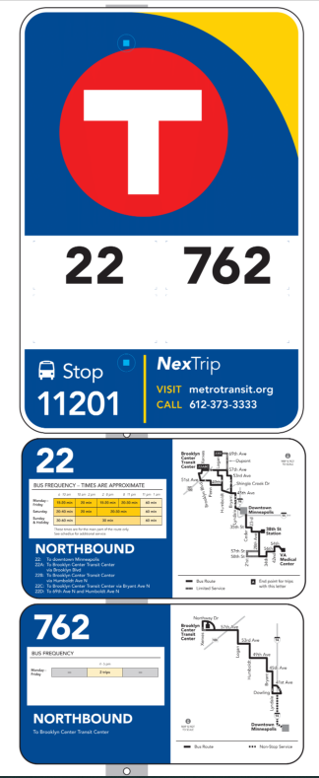
Project Overview
Last updated in 2017, bus stops with higher ridership and no shelter (Tier 2 stops) were treated to new sign panels that included:
  Route number, travel direction and destination(s)
  Frequency chart
  Simplified route map
Objective: Evaluate and conduct customer engagement and user testing to identify information needs at the stop-level point in the customer journey.

Slide 3
Project Timeline
Winter 2025: Existing conditions analysis and project scoping
Summer 2025: Community Engagement
  Focus groups, pop-ups and surveys on what information people want to see/prioritize
Winter 2025/26: Develop final recommendations
2026+: Implementation
We are here!

Slide 4
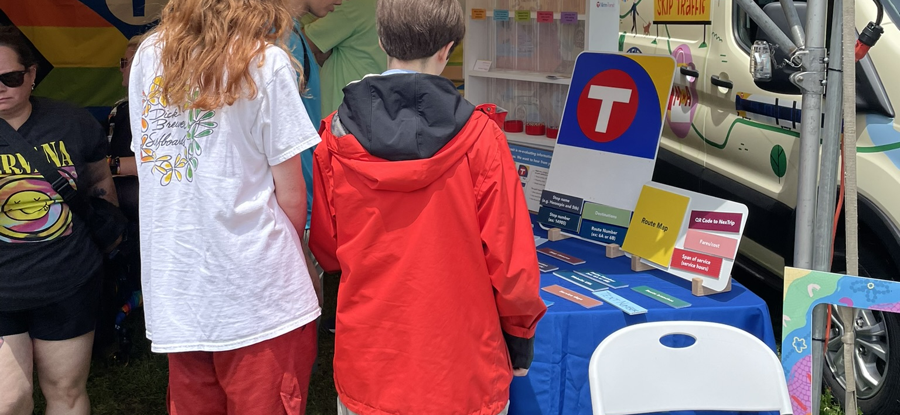
Engagement Findings

Slide 5
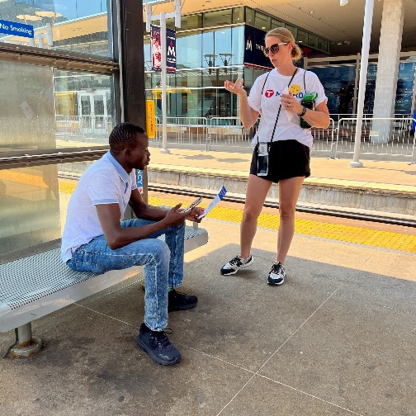
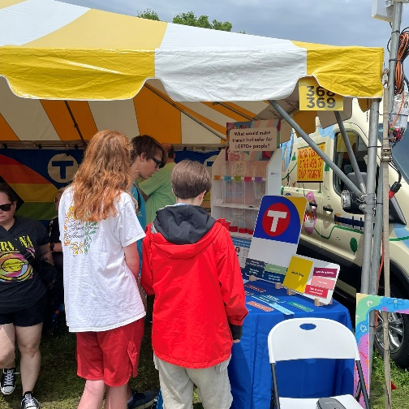
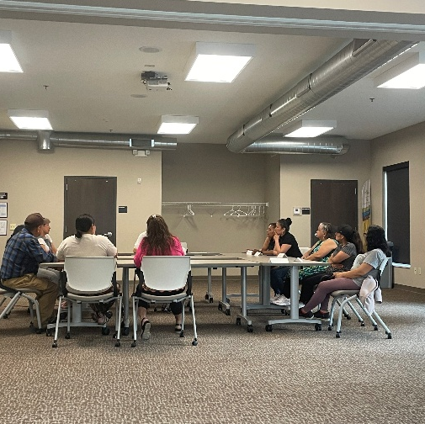
Engagement by the numbers
Online & In-Person Survey:
1,725 responses
(English, Spanish, Somali, Hmong)
Pop-ups:
100+ people engaged
(Juneteenth, Jazz Festival, Pride Festival)
Focus Groups:
40 participants
(Riders with Disabilities, New/Lapsed Riders, Spanish Speakers, Somali Speakers)

Slide 6
Key Findings by Rider Profile
Route and stop numbers, direction, and bus frequency are the most important stop-level bus sign information across riders.
Profile | Top Information to Include on Sign | Determining Direction at the Stop | Determining Bus Frequency at the Stop | Inclusive Design Elements
Riders with Disabilities | Route number, stop number, direction, maps, frequency | Use final destination, landmarks, and cardinal directions | Texting NexTrip, calling Metro Transit customer service, supplemental tools | Sign height, color contrast
New / Lapsed Riders | Route number, stop number, direction, maps, frequency | Use destination and landmarks | Supplemental tools, Texting NextTrip | Signs are difficult to locate
Spanish Speakers | Route number, frequency, translations | Use maps and landmarks | Supplemental tools | Text for non-English speakers
Somali Speakers | Frequency, bus fare | Ask the driver and other riders | Timetables | Text for non-English speakers
6

Slide 7
Comparisons to Survey Results
Online Survey: Top Information Wanted on Bus Signs*
Similarities and Differences
Route number, frequency (hours of operation and the days of the week the bus runs), travel direction, and stop number are identified in the groups a being the most important information for bus signs.
New and lapsed riders as well as Somali- speaking riders both identify bus fare details as key information. Some riders with a disability seek route maps and final destinations rather than travel direction for navigation purposes.
Top Info Also Identified in Focus Groups
*Survey results sourced from Metro Transit’s Stop-level Signage Evaluation engagement survey
7
Notes:
We also wanted to see how this compares to the 1000 of survey responses

Slide 8
Recommendations
Tier 2 Sign Updates
Reintroduce (more general) frequency information charts
Add stop name
Include location-specific QR code to connect riders with real-time information
Expand Tier 2 signs to additional locations
Pilot Approach & Goals
Pilot sign updates at select stops to test improvements before system-wide rollout
Improve internal coordination and information update workflow
Prioritize accessibility & clarity by designing for readability, ADA compliance and diverse rider needs

Slide 9
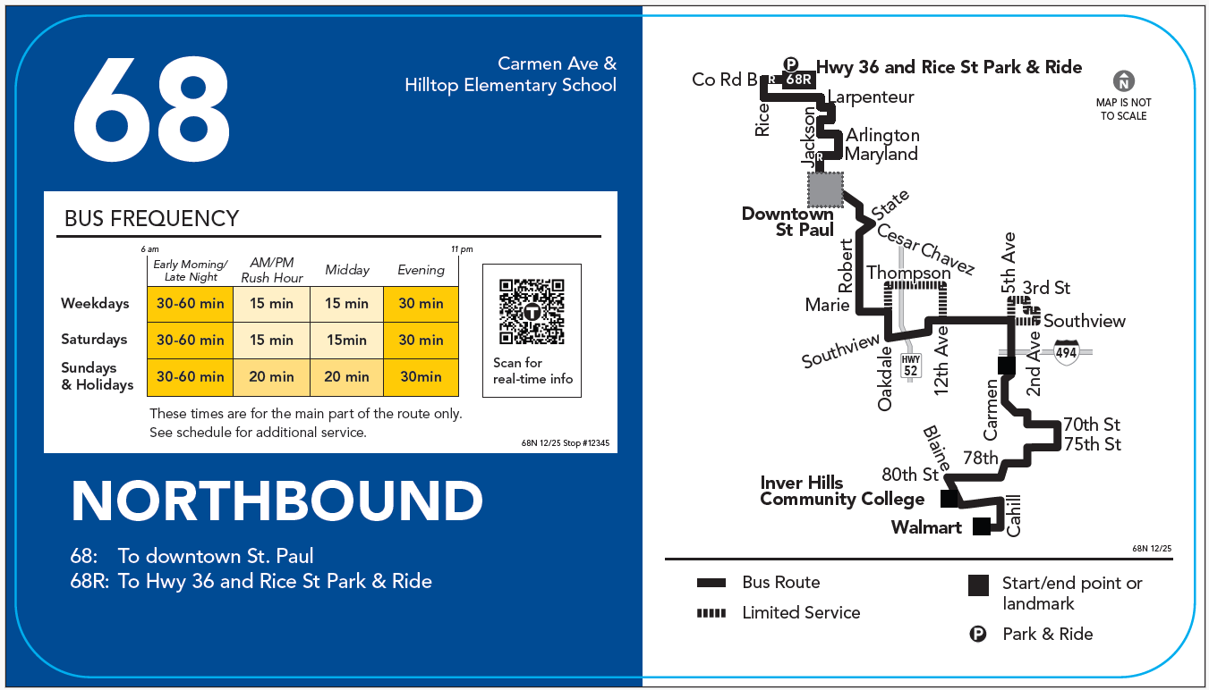
Updated Tier 2 stop sign

Slide 10
Next Steps
Launch pilot in Spring of 2026
Feedback & Evaluation: Collect data and evaluate internal process and user metrics
Plan for broader rollout if successful

Slide 11
Thank You!
Jasna Hadzic-Stanek
Jasna.Hadzic-Stanek@metrotransit.org

