Slide 1
Metro Transit
Equity & Inclusion Team
Equity Advisory Committee
April 20, 2020

Slide 2
Overview
Lesley Kandaras, Chief of Staff, E&I Team Executive Sponsor

Slide 3
Metro Transit Efforts to Advance Equity
Thrive MSP 2040 and the Metropolitan Council’s Equity Policy commit us to evaluating planning, operations, and investments through an equity lens
We are developing a more deliberate and intentional approach to embedding equity in our work, through
  Transit service we provide
  Programs to improve transit access and quality
  Organizational practices critical to equitable processes and outcomes

Slide 4
11/17/20 Discussion – EAC interest in partnering with us on current efforts
Initial examples include …
Developing transit equity vision and goals
Strengthening Metro Transit’s public engagement work
Developing transit equity metrics
Strengthening approach to evaluating transit service equity
Developing budgets and making budget decisions with an equity lens
Fostering a workplace that is diverse, equitable, and inclusive
Incorporating changes based on the Metropolitan Council’s Metro Transit Police Department Review
Strengthening approach to addressing “Equity” outcome as part of the Thrive Lens Analysis in Metropolitan Council business items
Contingent on future legislative action – providing guidance on policies/procedures to implement administrative citation alternative for fare evasion
…but we will adapt this list based on committee interests and priorities.

Slide 5
Equity & Inclusion Team
Sarah Berres, Specialist, Equity & Inclusion

Slide 6
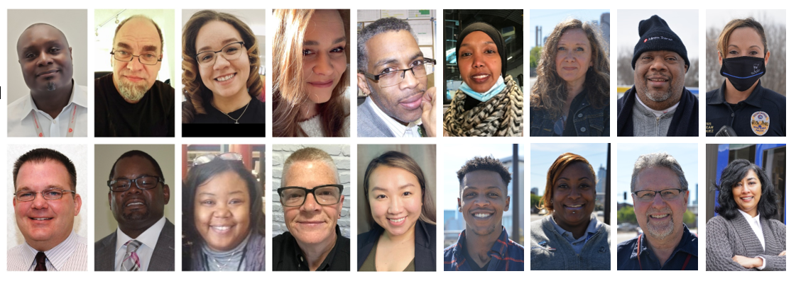
2021 Equity & Inclusion Team
Notes:
This year we expanded the Equity & Inclusion Team to allow for greater connection to and involvement of staff in equity work. We have senior managers, supervisors, office and frontline; male, female and nonbinary; Black, latino, Asian, Indian, East African and West African. These members are more than ambassadors to facilities, they bring their own ideas, vision and goals to the team. We lean into their leadership and their diversity of thought and perspective is embedded in senior leadership decision-making circles.
Membership
Representation from majority of facilities and departments
Internal engagement and external engagement committees
Two-year terms (staggered)
Paid work time
The E&I Team is supported by two full time Equity & Inclusion staff, an Equity Manager and the Chief of Staff as Executive Sponsor

Slide 7
Equity & Inclusion Team Charter
Mission
The Equity & Inclusion (E&I) Team influences equity goals and outcomes by activating staff involvement to
  Recognize and harness the value of the diversity of our region and workforce
  Develop creative ways to address the needs of staff and community members
  Support and expand Metro Transit’s commitment to equity and inclusion for employees and customers
Scope
  Equity action recommendation
  Internal communication activation
  Special projects as assigned or defined by team
  Support teams leading internal and external equity-related work

Slide 8
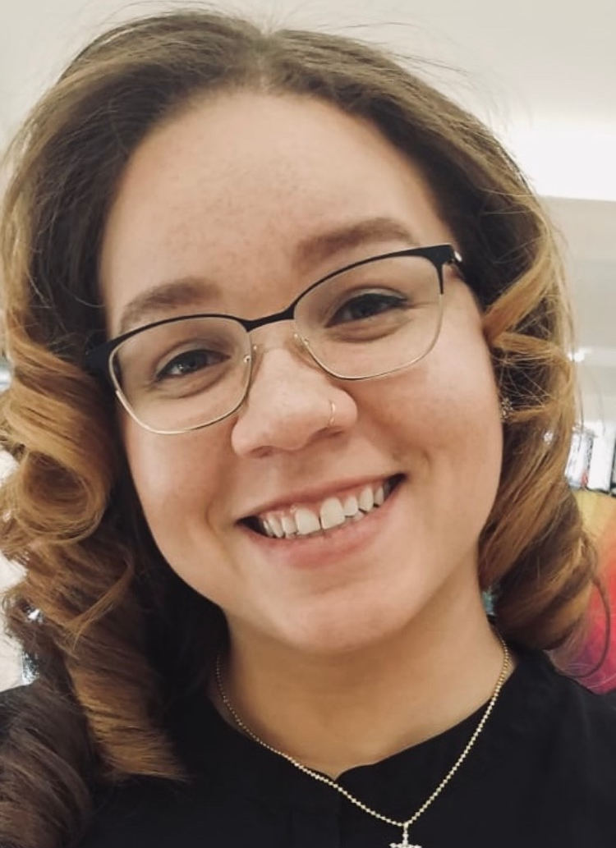
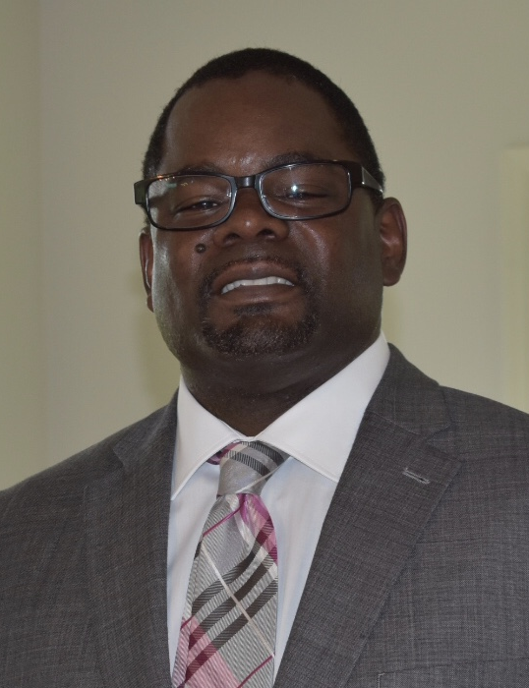
New Member Perspective
Erica Igure
Operator, Heywood Garage
Claudius Toussaint
Program Manager Real Estate and Asset Management, Engineering and Facilities

Slide 9
Team Focus 2021
Rachel Cagle, Coordinator, Equity & Inclusion

Slide 10
2021
  Goal: Establish monthly DEI-focused internal and external engagement
  Goal: Improve workplace culture through employee experience and supportive resources
  Goal: Establish E&I team recommendation process utilizing staff and community input to influence MT workplans
  Goal: Increase diversity of applicants in hiring pools
Notes:
Our workplan is not yet finalized for 2021. Within these goals are initiatives and projects that support our team’s 2020 Equity Recommendations and new programming ideas generated by continued discussion and work throughout MT.

Slide 11
Questions?

